Slide 1
1.1 – 1.2 Practice
Empirical Rule for Normal Distributions
Practice & Review

Slide 2
Let’s review what we’ve covered…
How does discrete data and continuous data differ?
How is a sample of data different than a population of data?
What is relative frequency?
What is a normal curve?
What is a normal distribution?
What symbol represents the mean of a population?
What symbol represents the mean of a sample?
What is standard deviation?
What symbols are used to represent standard deviation?
How does a lower standard deviation differ than a higher standard deviation?

Slide 3
Not in textbook.

Slide 4
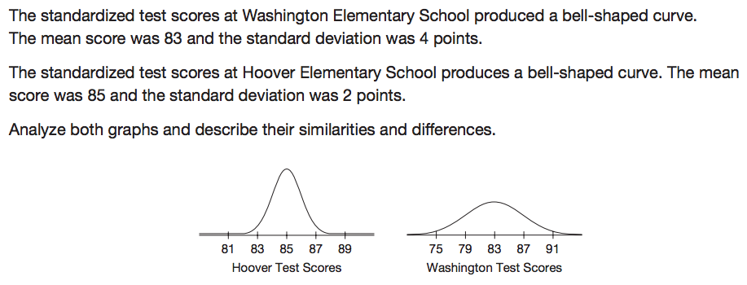
Review Practice: Not in textbook

Slide 5
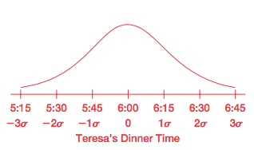
Review Practice: Not in textbook

Slide 6
Review Practice: Not in textbook

Slide 7
Review Practice: Not in textbook

Slide 8
Let’s review what we’ve covered…
What is a normal curve?
What is a normal distribution?
What symbol represents the mean of a population?
What symbol represents the mean of a sample?
What is standard deviation?
What symbols are used to represent standard deviation?
What is the Empirical rule for normal distributions?

Slide 9
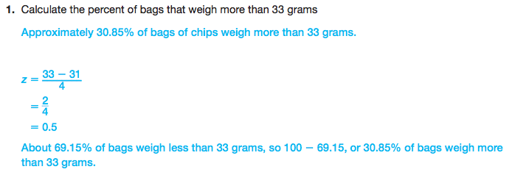
Review Practice: Not in textbook
Draw a sketch of the normal distribution to visualize the region you’re calculating.

Slide 10
Review Practice: Not in textbook

Slide 11
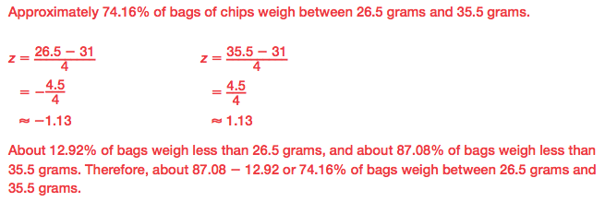
Review Practice: Not in textbook

Slide 12
Review Practice: Not in textbook

Slide 13
Review Practice: Not in textbook

Slide 14
Review Practice: Not in textbook

Slide 15
Review Practice: Not in textbook

Slide 16
Review Practice: Not in textbook

Slide 17
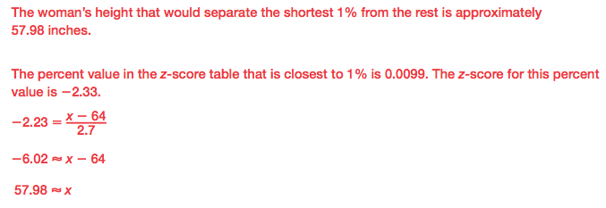
Review Practice: Not in textbook

Slide 18
Review Practice: Not in textbook

