Slide 1
1.1 Recharge it!
Normal Distributions

Slide 3
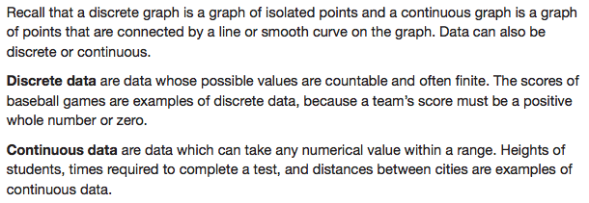

Slide 6
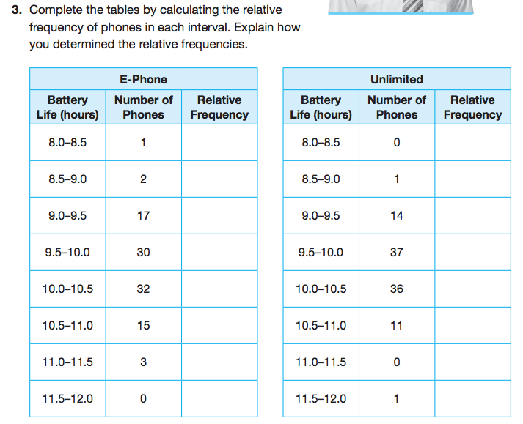

Slide 7
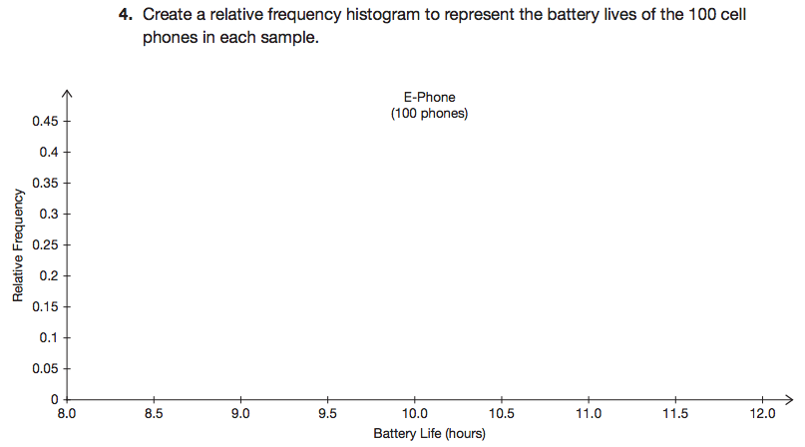
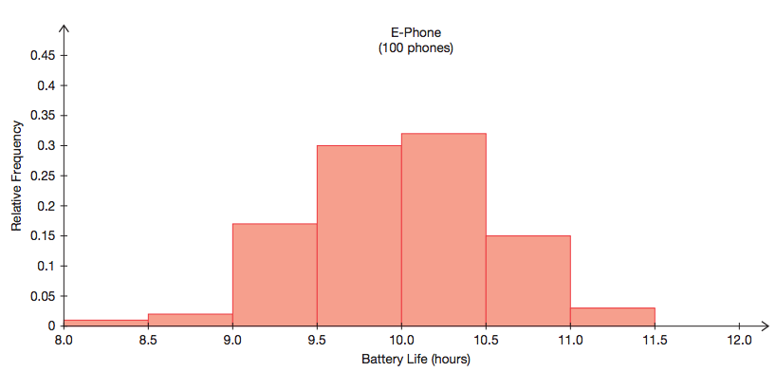

Slide 8
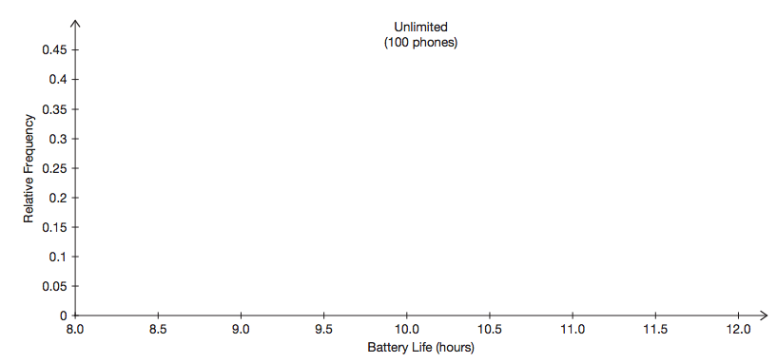
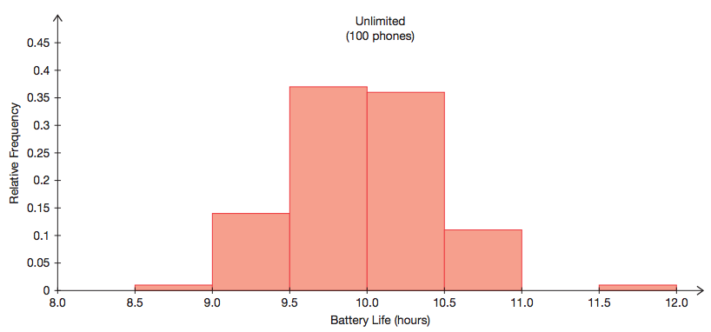

Slide 10
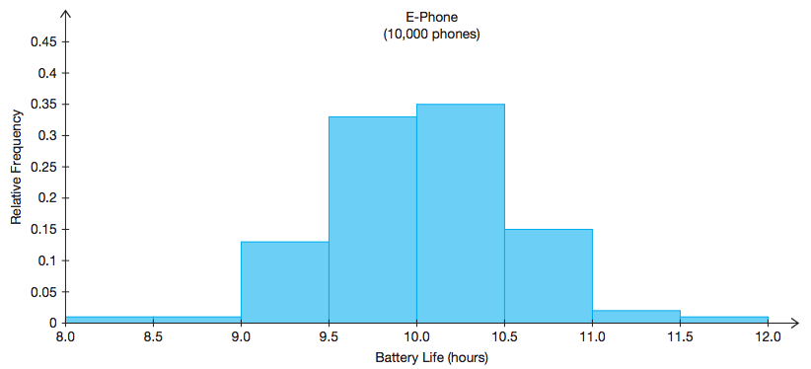

Slide 11
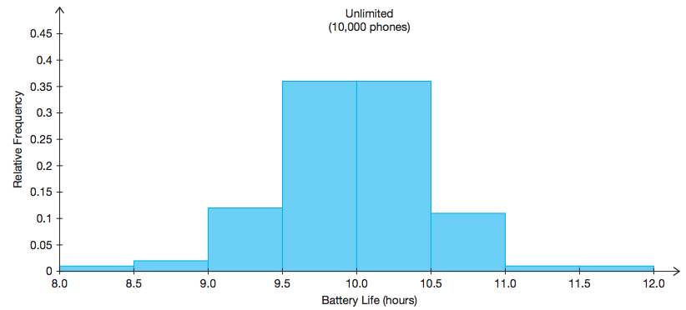

Slide 13
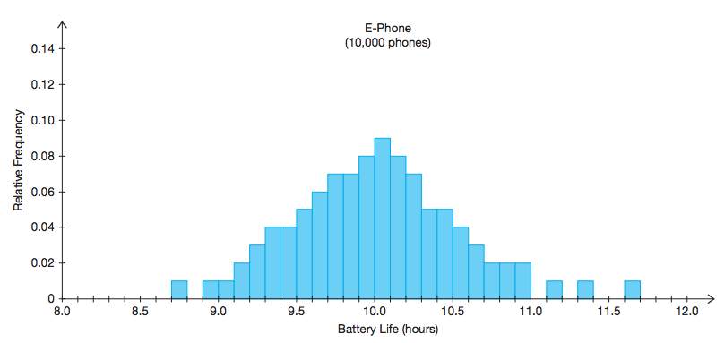

Slide 14
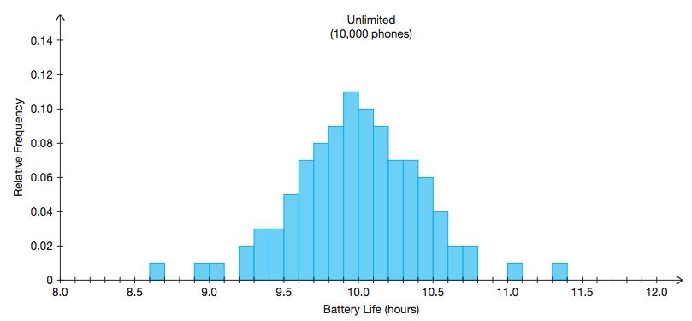

Slide 17
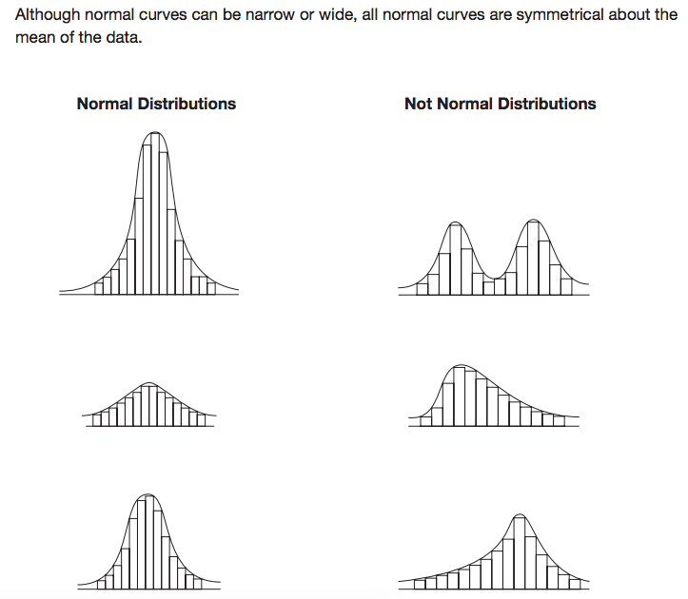

Slide 18
Let’s review what we’ve covered thus far…
How does discrete data and continuous data differ?
How is a sample of data different than a population of data?
What is relative frequency?
What is a normal curve?
What is a normal distribution?

Slide 20
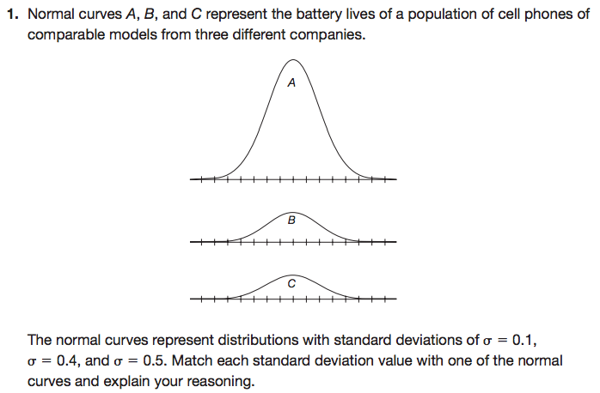

Slide 22
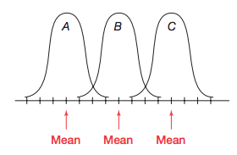

Slide 23
Let’s review what we’ve covered…
How does discrete data and continuous data differ?
How is a sample of data different than a population of data?
What is relative frequency?
What is a normal curve?
What is a normal distribution?
What symbol represents the mean of a population?
What symbol represents the mean of a sample?
What is standard deviation?
What symbols are used to represent standard deviation?
How does a lower standard deviation differ than a higher standard deviation?

Slide 24
Mathia time Keep out your notes and Mathia notebook.

