Slide 1
1.2 #I’mOnline
Empirical Rule for Normal Distributions

Slide 2
Let’s review what we’ve covered…
How does discrete data and continuous data differ?
How is a sample of data different than a population of data?
What is relative frequency?
What is a normal curve?
What is a normal distribution?
What symbol represents the mean of a population?
What symbol represents the mean of a sample?
What is standard deviation?
What symbols are used to represent standard deviation?
How does a lower standard deviation differ than a higher standard deviation?

Slide 3
Topic: 1.2 The Empirical Rule
Essential Questions:
What is the Empirical Rule for normal distributions?
How do you use it to identify the percentage of data in a given interval?

Slide 4
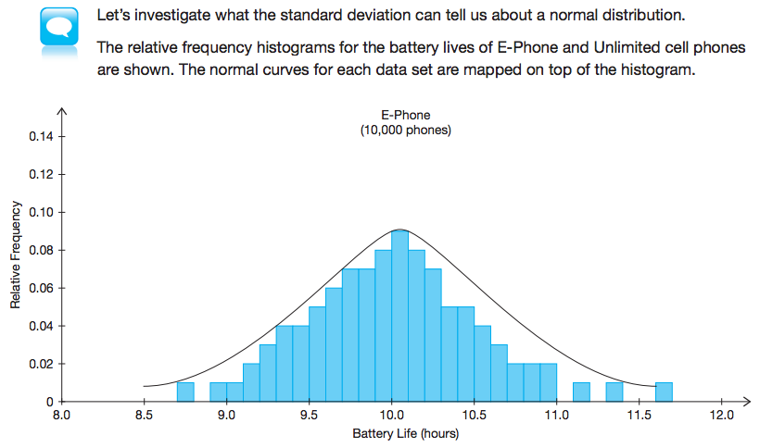

Slide 5
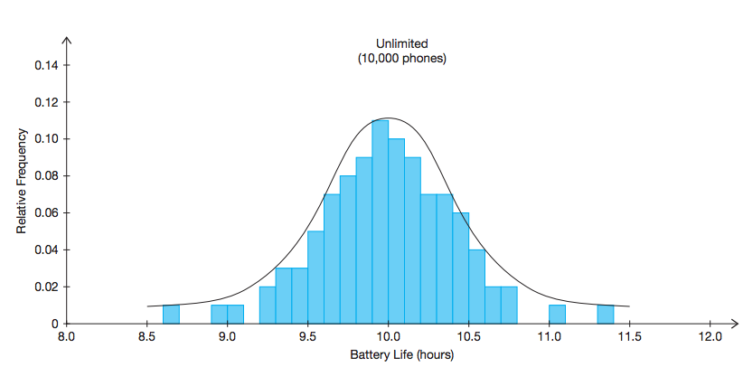

Slide 7
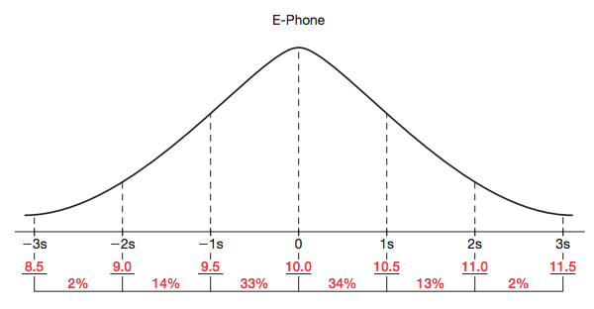
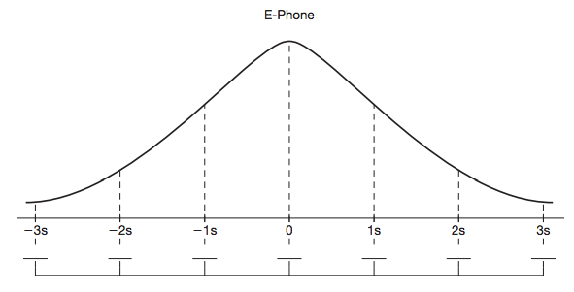

Slide 8
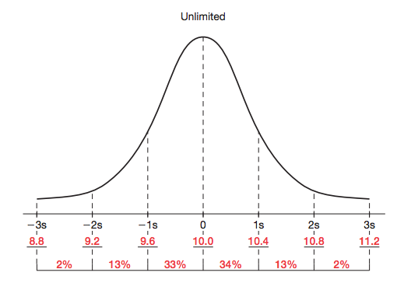
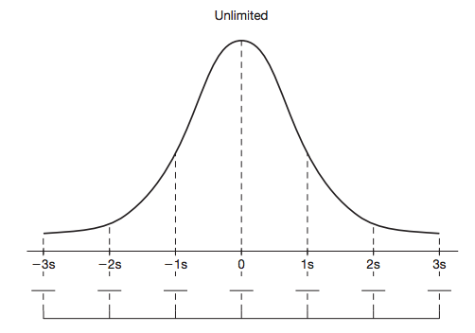

Slide 10
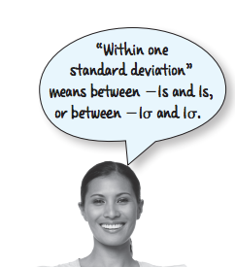

Slide 11
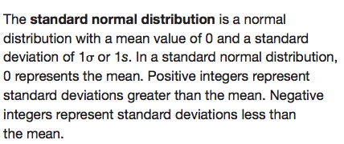
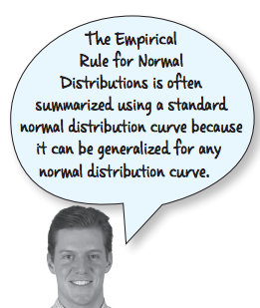
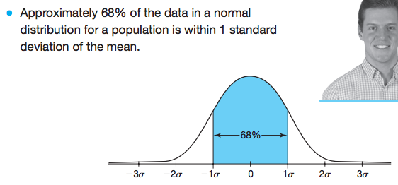

Slide 12
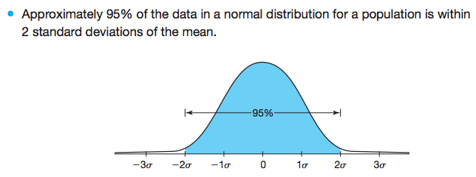

Slide 13
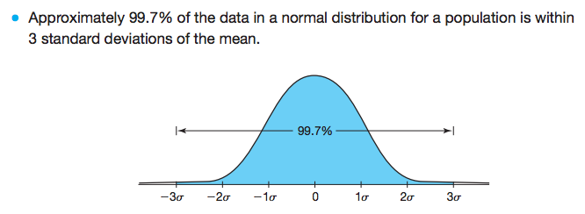

Slide 15
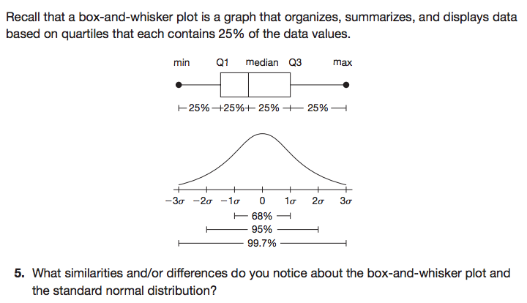

Slide 16
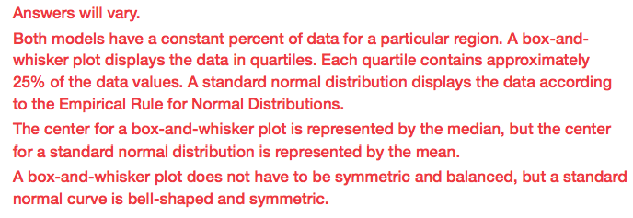

Slide 17
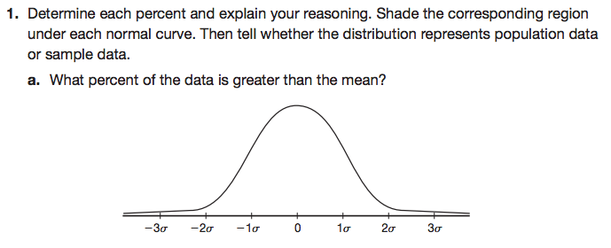
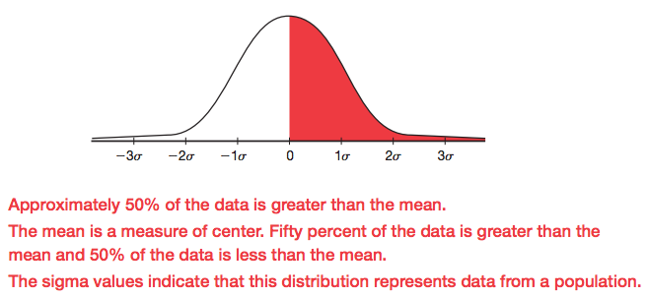

Slide 18
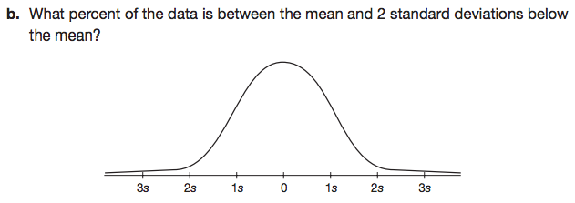
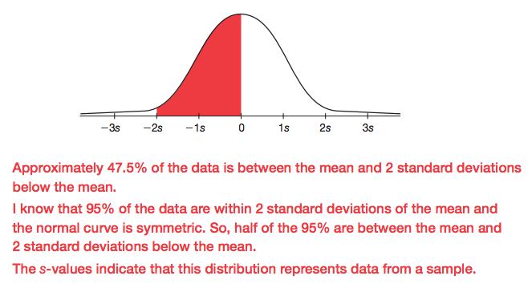

Slide 19
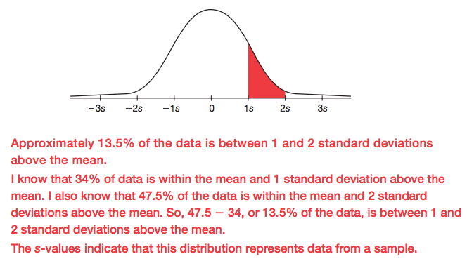

Slide 20
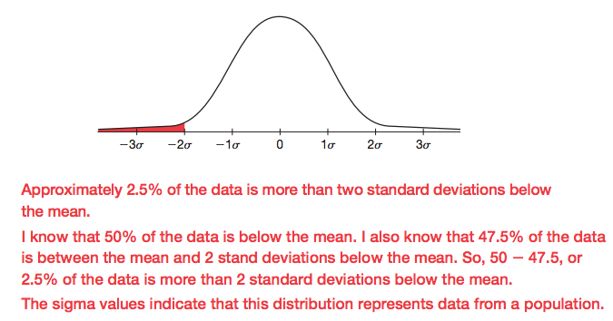

Slide 21
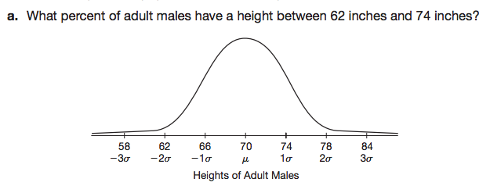
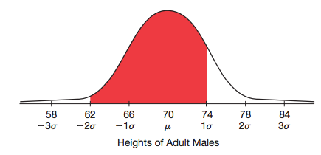
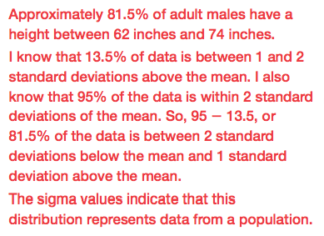

Slide 22
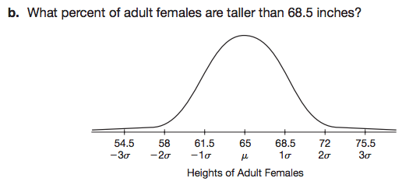
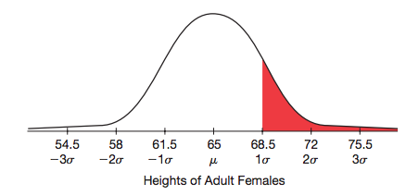

Slide 23
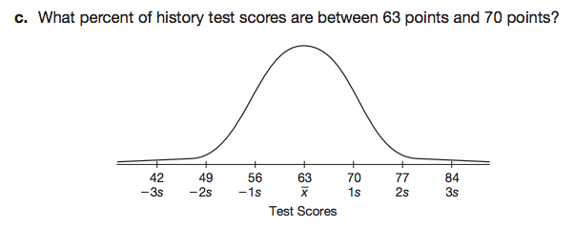
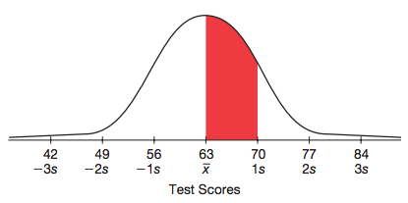

Slide 24
Let’s review what we’ve covered…
What is a normal curve?
What is a normal distribution?
What symbol represents the mean of a population?
What symbol represents the mean of a sample?
What is standard deviation?
What symbols are used to represent standard deviation?
What is the Empirical rule for normal distributions?

Slide 25
Mathia time Keep your notes and Mathia notebook out.

