Slide 1
1.3 Below the Line, Above the Line, and Between the Lines
Topic: 1.3 Z-Scores and Percentiles
Essential Question: How can you use Z-Scores to find percentiles in a Normal Distribution?

Slide 2
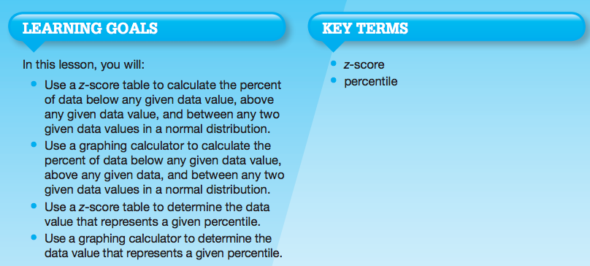

Slide 3
Let’s review what we’ve covered…
What is a normal curve?
What is a normal distribution?
What symbol represents the mean of a population?
What symbol represents the mean of a sample?
What is standard deviation?
What symbols are used to represent standard deviation?
What is the Empirical rule for normal distributions?

Slide 4
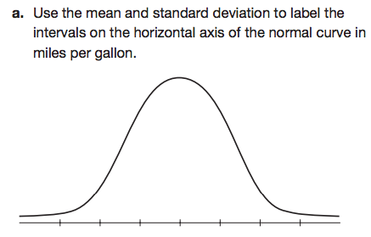
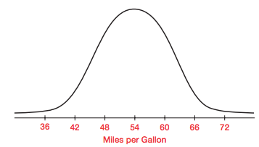

Slide 9
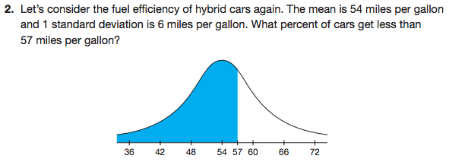

Slide 11
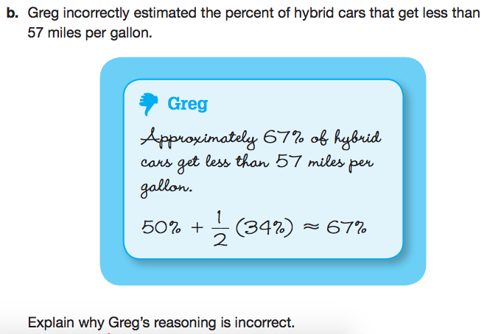

Slide 13
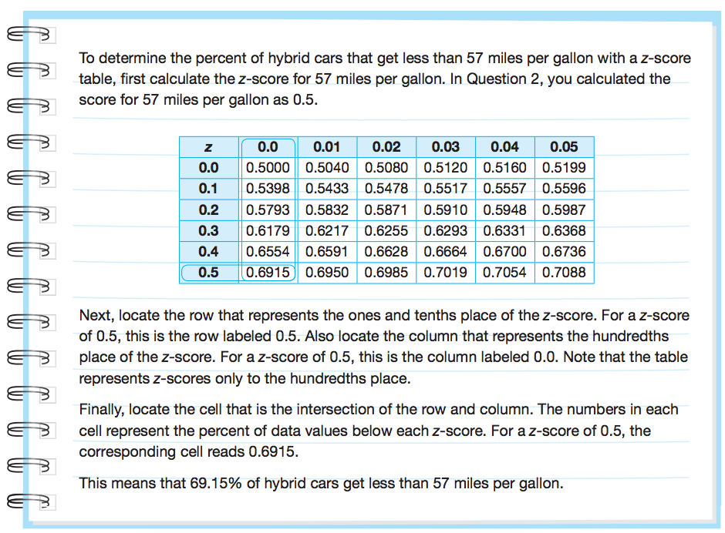
1
2
3
4

Slide 16
Let’s review what we’ve covered thus far…
What is a normal curve?
What is a normal distribution?
What is standard deviation?
What symbols are used to represent standard deviation?
What is the Empirical rule for normal distributions?
What is a z-score?
How is a z-score calculated?

Slide 20
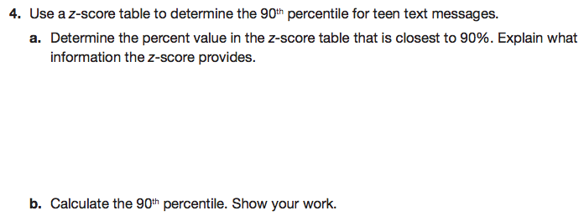

Slide 22
Let’s review what we’ve covered…
What is a normal curve?
What is a normal distribution?
What is standard deviation?
What symbols are used to represent standard deviation?
What is the Empirical rule for normal distributions?
What is a z-score?
How is a z-score calculated?
What is a percentile?
How do you determine a percentile?

Slide 23
Mathia time Keep your notes and Mathia notebook out.

