Slide 1
1.4 You Make the Call
Topic: 1.4 Normal Probability
Essential Question:
How do you use a Normal Distribution to find percentiles for situations involving probability?

Slide 3
Let’s review what we’ve covered…
What is a normal curve?
What is a normal distribution?
What is standard deviation?
What symbols are used to represent standard deviation?
What is the Empirical rule for normal distributions?
What is a z-score?
How is a z-score calculated?
What is a percentile?
How do you determine a percentile?

Slide 4
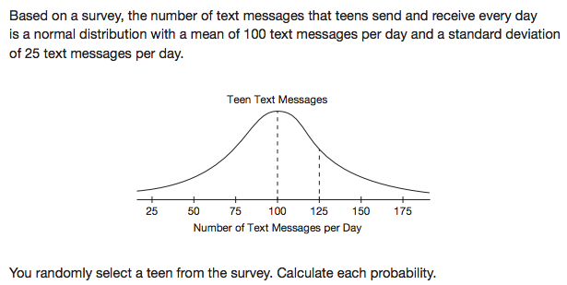

Slide 6
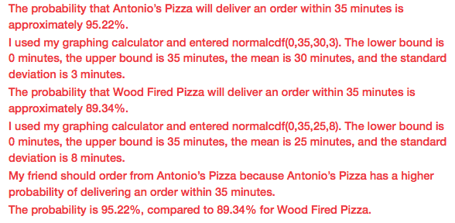

Slide 7
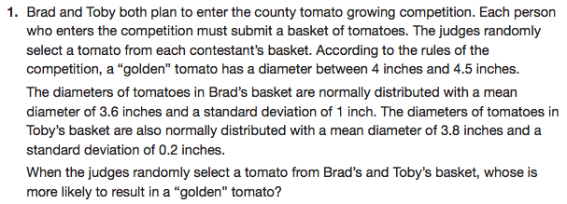

Slide 8
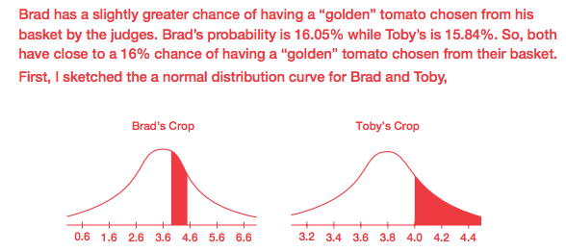

Slide 9
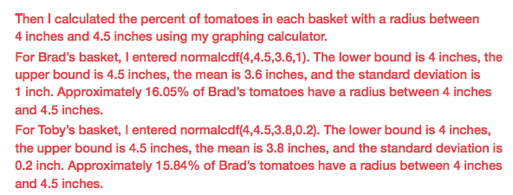

Slide 10
Let’s review what we’ve covered…
What is the Empirical rule for normal distributions?
What is a z-score?
How is a z-score calculated?
What is a percentile?
How do you determine a percentile?
How do you determine the probability of a given data value within a normal distribution?

Slide 11
Mathia time Keep your notes and Mathia notebook out.

