Slide 1
Ch 11 Sample Surveys
PART 1 Support

Slide 2
Background
We have learned ways to display, describe, and summarize data, but have been limited to examining the particular batch of data we have.
To make decisions, we need to go beyond the data at hand and to the world at large.
Let’s investigate three major ideas that will allow us to make this stretch…

Slide 3
Idea 1: Examine a Part of the Whole
The first idea is to draw a sample.
We’d like to know about an entire population of individuals, but examining all of them is usually impractical, if not impossible.
We settle for examining a smaller group of individuals—a sample—selected from the population.

Slide 4
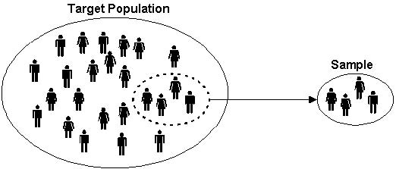
Idea 1: Examine a Part of the Whole

Slide 5
Idea 1: Examine Part of the Whole
Opinion polls are examples of sample surveys, designed to ask questions of a small group of people in the hope of learning something about the entire population.
Professional pollsters work quite hard to ensure that the sample they take is representative of the population.
If not, the sample can give misleading information about the population.

Slide 6
Avoiding Bias
Sampling methods that, by their nature, tend to over- or under- emphasize some characteristics of the population are said to be biased.
Bias is the bane of sampling—the one thing above all to avoid.
There is usually no way to fix a biased sample and no way to salvage useful information from it.
The best way to avoid bias is to select individuals for the sample at random.

Slide 7
Idea 2: Randomize
Randomization can protect you against factors that you know are in the data.
It can also help protect against factors you are not even aware of.
Randomizing protects us from the influences of all the features of our population, even ones that we may not have thought about.
Randomizing makes sure that on the average the sample looks like the rest of the population.

Slide 8
Idea 3: It’s the Sample Size
How large a random sample do we need for the sample to be reasonably representative of the population?
It’s the size of the sample, not the size of the population, that makes the difference in sampling.
Exception: If the population is small enough and the sample is more than 10% of the whole population, the population size can matter.
The fraction of the population that you’ve sampled doesn’t matter. It’s the sample size itself that’s important.

Slide 9
Does a Census Make Sense?
Census – survey of the entire population.
Problems:
Difficult to survey everyone
Populations change
Too complex and may not show 100% results

Slide 10
Simple Random Samples
We draw samples because we can’t work with the entire population.
We need to be sure that the statistics we compute from the sample reflect the corresponding parameters accurately.
A sample that does this is said to be representative.

Slide 11
SAMPLING METHODS
The ways to properly conduct a survey to avoid bias and to correctly represent the population.

Slide 12
Common Sampling Methods
Each has a design or method to achieve randomness, avoid bias, and/or collect the desired data.
1) Simple Random Sample (SRS)
2) Stratified
3) Cluster
4) Multistage
5) Systematic

Slide 13
1) Simple Random Samples
We will insist that every possible sample of the size we plan to draw has an equal chance to be selected.
A sample drawn in this way is called a Simple Random Sample (SRS).
An SRS is the standard against which we measure other sampling methods, and the sampling method on which the theory of working with sampled data is based.
This is similar to our randomness concepts in Ch 10.

Slide 14
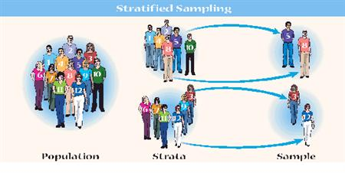
2) Stratified Sampling
The population is first sliced into homogeneous groups, called strata, before the sample is selected.
Break into groups of similar type, then randomly choose from each group.
Helps with comparing groups within a population.

Slide 15
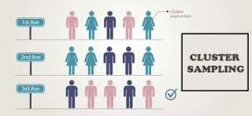
3) Cluster Sampling
Dividing the population into random heterogeneous groups, then choosing some from each cluster or within a cluster.
Useful if surveying groups of students or districts in order to still create randomness in order to reduce bias.

Slide 16
Cluster sampling is not the same as stratified sampling.
We stratify to ensure that our sample represents different groups in the population, and sample randomly within each stratum.
Strata are internally homogeneous, but differ from one another.
Clusters are more or less alike, are internally heterogeneous and each resembling the overall population.
We select clusters to make sampling more practical or affordable.

Slide 17
4) Multistage Sampling
Sometimes we use a variety of sampling methods together.
Sampling schemes that combine several methods are called multistage samples.
Most surveys conducted by professional polling organizations use some combination of stratified and cluster sampling as well as simple random sampling.

Slide 18
5) Systematic Samples
Sometimes we draw a sample by selecting individuals systematically.
For example, you might survey every 10th person on an alphabetical list of students.
When there is no reason to believe that the order of the list could be associated in any way with the responses sought, systematic sampling can give a representative sample.

