Slide 1
Ch 12 Studies & Experiments
Part 3 Support

Slide 2
The Best Experiments…
The best experiments are usually:
randomized.
comparative.
double-blind.
a control group (either placebo or a standard treatment)

Slide 3
Blocking
When groups of experimental units are similar, it’s often a good idea to gather them together into blocks.
Blocking isolates the variability due to the differences between the blocks so that we can see the differences due to the treatments more clearly.
When randomization occurs only within the blocks, we call the design a randomized block design.

Slide 4
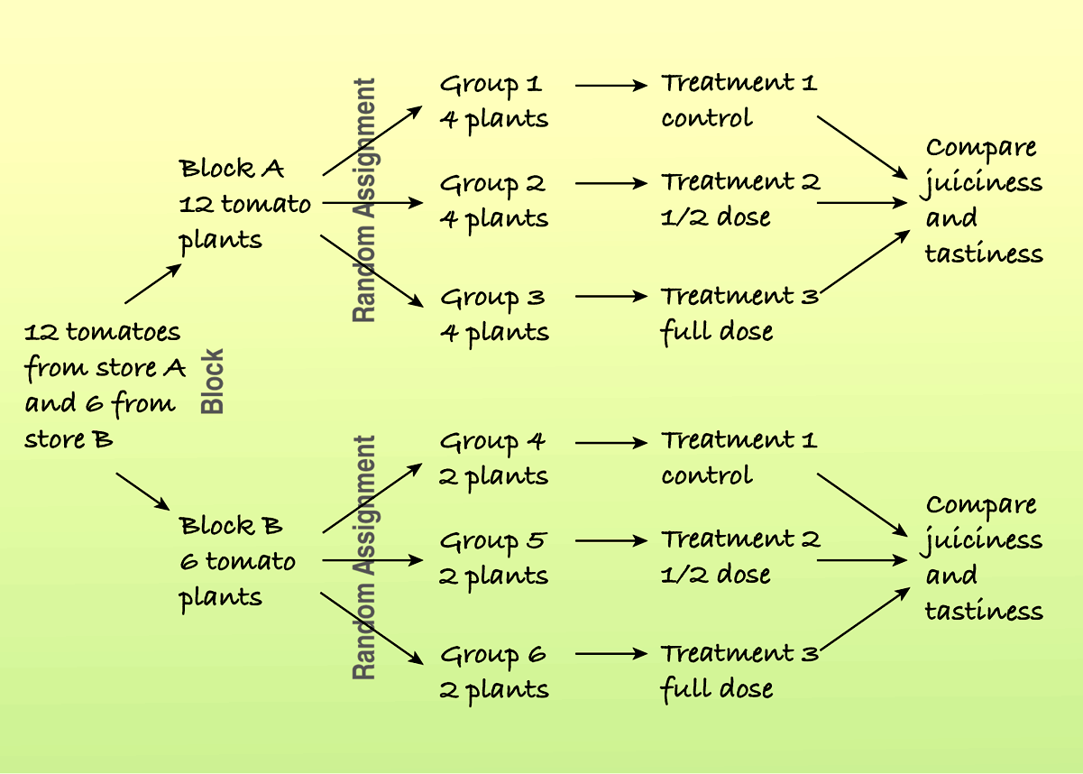
Blocking (cont.)
Here is a diagram of a blocked experiment:

Slide 5
Blocking (cont.)
Blocking is the same idea for experiments as stratifying is for sampling.
Both methods group together subjects that are similar and randomize within those groups as a way to remove unwanted variation.
We use blocks to reduce variability so we can see the effects of the factors; we’re not usually interested in studying the effects of the blocks themselves.

Slide 6
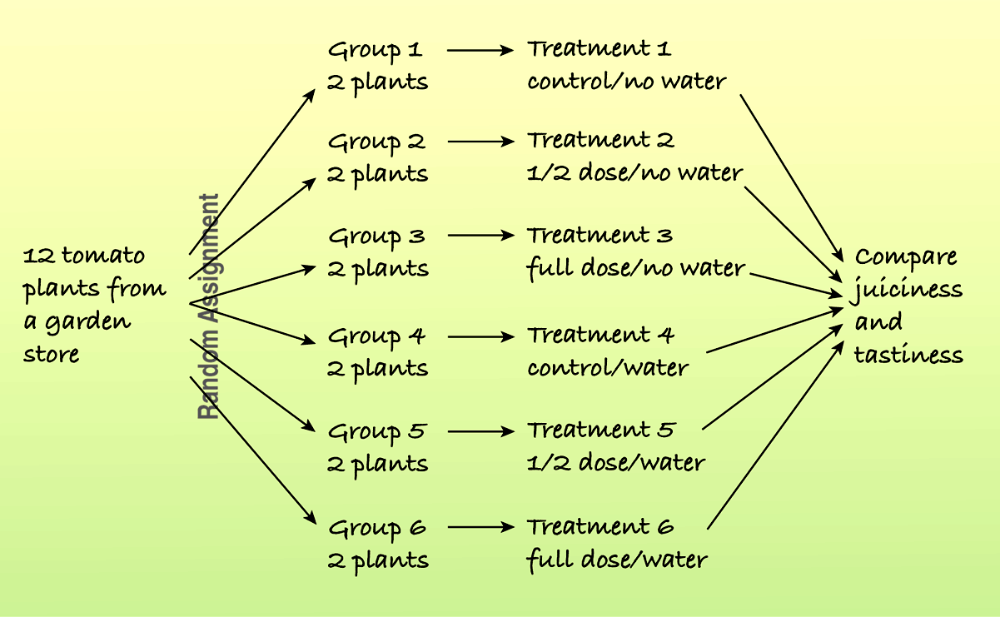
Adding More Factors (cont.)
For example, the following diagram shows a study of the effects of different fertilizer/water combinations on the juiciness and tastiness of tomatoes:

Slide 7
Confounding
When the levels of one factor are associated with the levels of another factor, we say that these two factors are confounded.
When we have confounded factors, we cannot separate out the effects of one factor from the effects of the other factor.

Slide 8
Confounding example
We wish to see if detergent A cleans better than detergent B.
Detergent A is used in one washing machine and detergent B is used in a different machine.
At the end of this experiment, we have confounding. That is, we cannot tell if a difference in the cleanliness of the clothes is caused by the detergent or by the quality of the machine that was used.

Slide 9
Lurking Variables
A variety of variables may be influencing a given situation.
Sometimes isolating the effect of one variable may be difficult.
There may be “lurking” variables that we need to think about. We sometimes discuss the potential effects of these other variables.

Slide 10
What Can Go Wrong?
Don’t give up just because you can’t run an experiment.
If we can’t perform an experiment, often an observational study is a good choice.
Beware of confounding.
Use randomization whenever possible to ensure that the factors not in your experiment are not confounded with your treatment levels.
Be alert to confounding that cannot be avoided, and report it along with your results.

Slide 11
What Can Go Wrong?
Bad things can happen even to good experiments.
Protect yourself by recording additional information.
Don’t spend your entire budget on the first run.
Try a small pilot experiment before running the full-scale experiment.
You may learn some things that will help you make the full-scale experiment better.

Slide 12
What have we learned?
We can recognize sample surveys, observational studies, and randomized comparative experiments.
These methods collect data in different ways and lead us to different conclusions.
We can identify retrospective and prospective observational studies and understand the advantages and disadvantages of each.
Only well-designed experiments can allow us to reach cause-and-effect conclusions.
We manipulate levels of treatments to see if the factor we have identified produces changes in our response variable.

Slide 13
What have we learned?
We know the principles of experimental design:
Identify and control as many other sources of variability as possible so we can be sure that the variation in the response variable can be attributed to our factor.
Try to equalize the many possible sources of variability that cannot be identified by randomly assigning experimental units to treatments.
Replicate the experiment on as many subjects as possible.
Control the sources of variability we can, and consider blocking to reduce variability from sources we recognize but cannot control.

Slide 14
What have we learned?
We’ve learned the value of having a control group and of using blinding and placebo controls.
We can recognize problems posed by confounding variables in experiments and lurking variables in observational studies.

