Slide 1
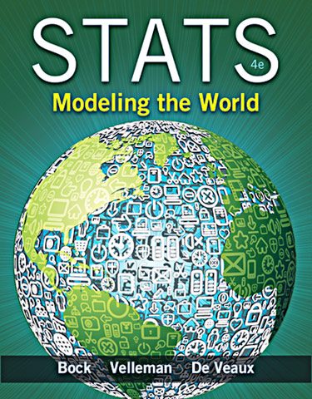
Chapter 17
Sampling Distribution Models

Slide 2
The Central Limit Theorem for Sample Proportions
Rather than showing real repeated samples, imagine what would happen if we were to actually draw many samples.
Now imagine what would happen if we looked at the sample proportions for these samples.
The histogram we’d get if we could see all the proportions from all possible samples is called the sampling distribution of the proportions.
What would the histogram of all the sample proportions look like?

Slide 3
Modeling the Distribution of Sample Proportions (cont.)
We would expect the histogram of the sample proportions to center at the true proportion, p, in the population.
As far as the shape of the histogram goes, we can simulate a bunch of random samples that we didn’t really draw.
It turns out that the histogram is unimodal, symmetric, and centered at p.
More specifically, it’s an amazing and fortunate fact that a Normal model is just the right one for the histogram of sample proportions.

Slide 4
Modeling the Distribution of Sample Proportions (cont.)
Modeling how sample proportions vary from sample to sample is one of the most powerful ideas we’ll see in this course.
A sampling distribution model for how a sample proportion varies from sample to sample allows us to quantify that variation and how likely it is that we’d observe a sample proportion in any particular interval.
To use a Normal model, we need to specify its mean and standard deviation. We’ll put µ, the mean of the Normal, at p.

Slide 5
Modeling the Distribution of Sample Proportions (cont.)
When working with proportions, knowing the mean automatically gives us the standard deviation as well—the standard deviation we will use is
So, the distribution of the sample proportions is modeled with a probability model that is

Slide 6
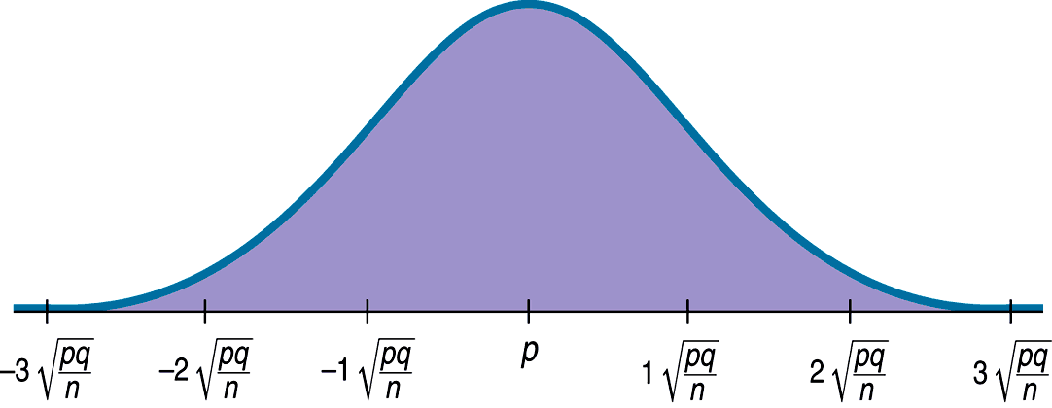
Modeling the Distribution of Sample Proportions (cont.)
A picture of what we just discussed is as follows:

Slide 7
The Central Limit Theorem for Sample Proportions (cont)
Because we have a Normal model, for example, we know that 95% of Normally distributed values are within two standard deviations of the mean.
So we should not be surprised if 95% of various polls gave results that were near the mean but varied above and below that by no more than two standard deviations.
This is what we mean by sampling error. It’s not really an error at all, but just variability you’d expect to see from one sample to another. A better term would be sampling variability.

Slide 8
Assumptions and Conditions
Most models are useful only when specific assumptions are true.
There are two assumptions in the case of the model for the distribution of sample proportions:
The Independence Assumption: The sampled values must be independent of each other.
The Sample Size Assumption: The sample size, n, must be large enough.

Slide 9
Assumptions and Conditions (cont.)
Randomization Condition: The sample should be a simple random sample of the population.
10% Condition: the sample size, n, must be no larger than 10% of the population.
Success/Failure Condition: The sample size has to be big enough so that both np (number of successes) and nq (number of failures) are at least 10.
…So, we need a large enough sample that is not too large.

Slide 10
A Sampling Distribution Model for a Proportion
A proportion is no longer just a computation from a set of data.
It is now a random variable quantity that has a probability distribution.
This distribution is called the sampling distribution model for proportions.
Even though we depend on sampling distribution models, we never actually get to see them.
We never actually take repeated samples from the same population and make a histogram. We only imagine or simulate them.

Slide 11
The Sampling Distribution Model for a Proportion (cont.)
Provided that the sampled values are independent and the sample size is large enough, the sampling distribution of is modeled by a Normal model with
Mean:
Standard deviation:

Slide 12
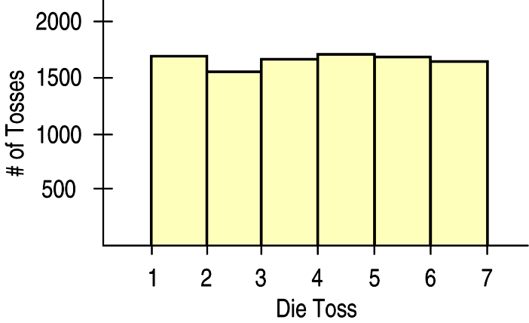
Means – The “Average” of One Die
Let’s start with a simulation of 10,000 tosses of a die. A histogram of the results is:

Slide 13
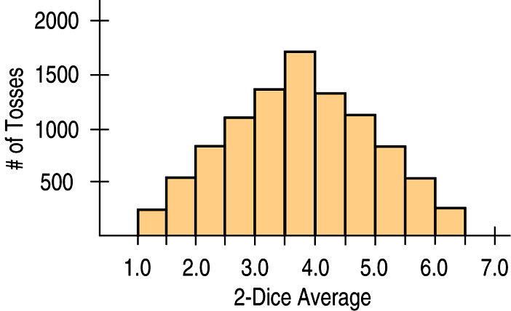
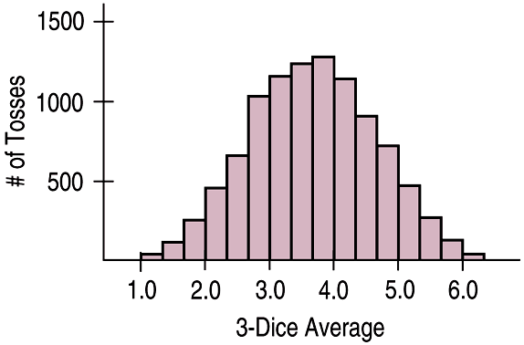
Means – Averaging More Dice
Looking at the average of two dice after a simulation of 10,000 tosses:
The average of three dice after a simulation of 10,000 tosses looks like:

Slide 14
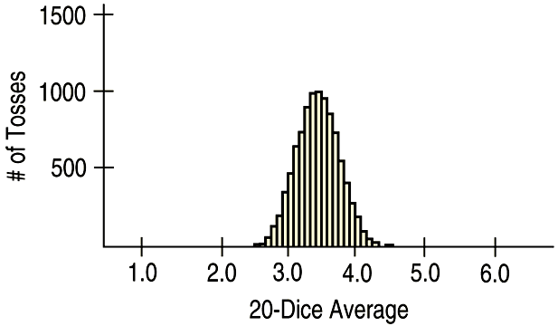
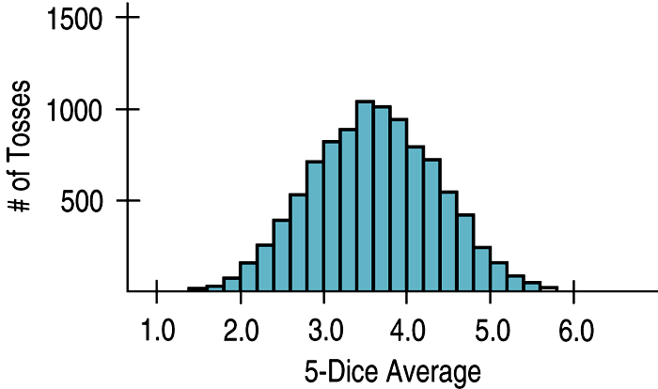
Means – Averaging Still More Dice
The average of 5 dice after a simulation of 10,000 tosses looks like:
The average of 20 dice after a simulation of 10,000 tosses looks like:

Slide 15
Means – What the Simulations Show
As the sample size (number of dice) gets larger, each sample average is more likely to be closer to the population mean.
So, we see the shape continuing to tighten around 3.5
And, it probably does not shock you that the sampling distribution of a mean becomes Normal.

Slide 16
The Fundamental Theorem of Statistics
The sampling distribution of any mean becomes more nearly Normal as the sample size grows.
All we need is for the observations to be independent and collected with randomization.
We don’t even care about the shape of the population distribution!
The Fundamental Theorem of Statistics is called the Central Limit Theorem (CLT).

Slide 17
The Fundamental Theorem of Statistics (cont.)
The CLT is surprising and a bit weird:
Not only does the histogram of the sample means get closer and closer to the Normal model as the sample size grows, but this is true regardless of the shape of the population distribution.
The CLT works better (and faster) the closer the population model is to a Normal itself. It also works better for larger samples.

Slide 18
The Fundamental Theorem of Statistics (cont.)
The Central Limit Theorem (CLT)
The mean of a random sample is a random variable whose sampling distribution can be approximated by a Normal model. The larger the sample, the better the approximation will be.

Slide 19
Assumptions and Conditions
The CLT requires essentially the same assumptions we saw for modeling proportions:
Independence Assumption: The sampled values must be independent of each other.
Sample Size Assumption: The sample size must be sufficiently large.

Slide 20
Assumptions and Conditions (cont.)
We can’t check these directly, but we can think about whether the Independence Assumption is plausible. We can also check some related conditions:
Randomization Condition: The data values must be sampled randomly.
10% Condition: When the sample is drawn without replacement, the sample size, n, should be no more than 10% of the population.
Large Enough Sample Condition: The CLT doesn’t tell us how large a sample we need. For now, you need to think about your sample size in the context of what you know about the population.

Slide 21
But Which Normal?
The CLT says that the sampling distribution of any mean or proportion is approximately Normal.
But which Normal model?
For proportions, the sampling distribution is centered at the population proportion.
For means, it’s centered at the population mean.
But what about the standard deviations?

Slide 22
But Which Normal? (cont.)
The Normal model for the sampling distribution of the mean has a standard deviation equal to
where σ is the population standard deviation.

Slide 23
But Which Normal? (cont.)
The Normal model for the sampling distribution of the proportion has a standard deviation equal to

Slide 24
About Variation
The standard deviation of the sampling distribution declines only with the square root of the sample size (the denominator contains the square root of n).
Therefore, the variability decreases as the sample size increases.
While we’d always like a larger sample, the square root limits how much we can make a sample tell about the population. (This is an example of the Law of Diminishing Returns.)

Slide 25
The Real World and the Model World
Be careful! Now we have two distributions to deal with.
The first is the real world distribution of the sample, which we might display with a histogram.
The second is the math world sampling distribution of the statistic, which we model with a Normal model based on the Central Limit Theorem.
Don’t confuse the two!

Slide 26
Sampling Distribution Models
Always remember that the statistic itself is a random quantity.
We can’t know what our statistic will be because it comes from a random sample.
Fortunately, for the mean and proportion, the CLT tells us that we can model their sampling distribution directly with a Normal model.

Slide 27
Sampling Distribution Models (cont.)
There are two basic truths about sampling distributions:
Sampling distributions arise because samples vary. Each random sample will have different cases and, so, a different value of the statistic.
Although we can always simulate a sampling distribution, the Central Limit Theorem saves us the trouble for means and proportions.

Slide 28
Sampling Distribution Models (cont.)
Our parameter does not vary. It is a true value about the population that is not changing. Often we never know the value of a parameter.
Election Day is one of the few times when we find out of the value of the parameter! At the end, the votes are counted, and we find out how good of a job the pollsters did!

Slide 29
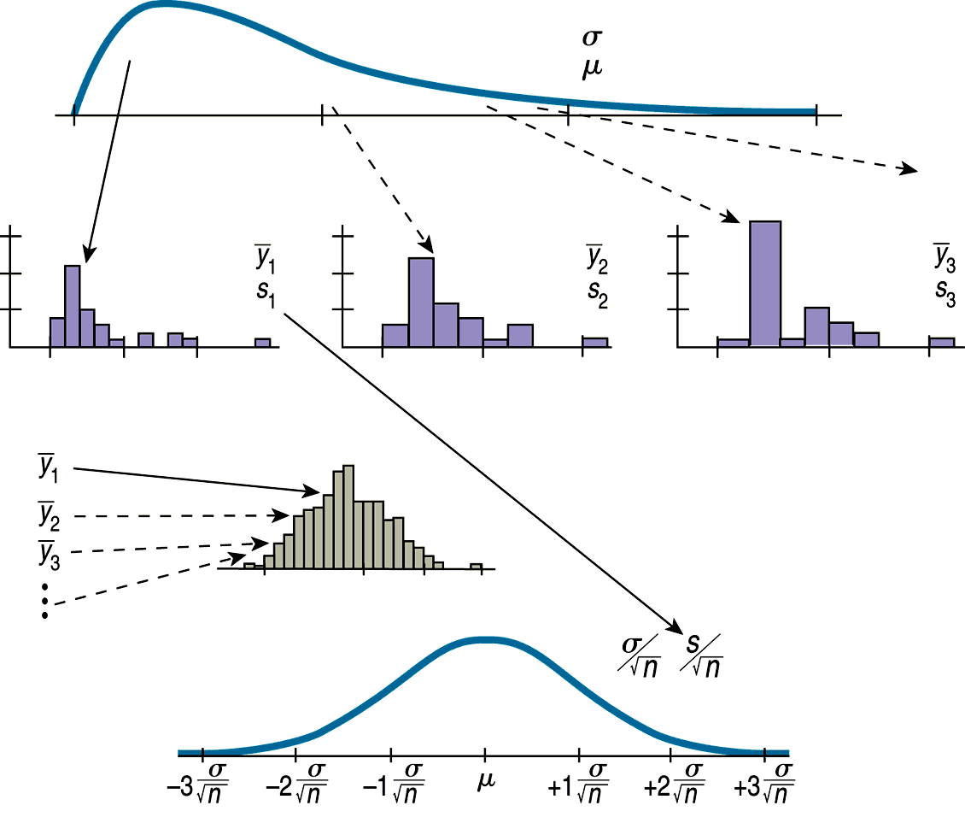
The Process Going Into the Sampling Distribution Model

Slide 30
What Can Go Wrong?
Don’t confuse the sampling distribution with the distribution of the sample.
When you take a sample, you look at the distribution of the values, usually with a histogram, and you may calculate summary statistics.
The sampling distribution is an imaginary collection of the values that a statistic might have taken for all random samples—the one you got and the ones you didn’t get.

Slide 31
What Can Go Wrong? (cont.)
Beware of observations that are not independent.
The CLT depends crucially on the assumption of independence.
You can’t check this with your data—you have to think about how the data were gathered.
Watch out for small samples from skewed populations.
The more skewed the distribution, the larger the sample size we need for the CLT to work.

