Slide 1
Chapter 19
Testing Hypotheses about Proportions

Slide 2
Hypotheses
Hypotheses are working models that we adopt temporarily.
Our starting hypothesis is called the null hypothesis.
The null hypothesis, that we denote by H₀, specifies a population model parameter of interest and proposes a value for that parameter.
We usually write down the null hypothesis in the form H₀: parameter = hypothesized value.

Slide 3
Hypotheses
The alternative hypothesis, which we denote by H_{A}, contains the values of the parameter that we consider plausible if we reject the null hypothesis.
Our question of inquiry determines our H_{A}.
For example, if we hope to find evidence that the new medication decreases the percent of infection, our H_{A} will be that p is less than the current percent.

Slide 4
Hypotheses (cont.)
The null hypothesis, specifies a population model parameter of interest and proposes a value for that parameter.
We might have, for example, H₀: p = 0.20, as in the chapter example.
We want to compare our data to what we would expect given that H₀ is true.
We can do this by finding out how many standard deviations away from the proposed value we are.
We then ask how likely it is to get results like we did if the null hypothesis were true.

Slide 5
A Trial as a Hypothesis Test
Think about the logic of jury trials:
To prove someone is guilty, we start by assuming they are innocent.
We retain that hypothesis until the facts make it unlikely beyond a reasonable doubt.
Then, and only then, we reject the hypothesis of innocence and declare the person guilty.

Slide 6
A Trial as a Hypothesis Test (cont.)
The same logic used in jury trials is used in statistical tests of hypotheses:
We begin by assuming that a hypothesis is true.
Next we consider whether the data are consistent with the hypothesis.
If they are, all we can do is retain the hypothesis we started with. If they are not, then like a jury, we ask whether they are unlikely beyond a reasonable doubt.

Slide 7
P-Values
The key statistical insight is that we can quantify our level of doubt.
We can use the model proposed by our hypothesis to calculate the probability that the event we’ve witnessed could happen.
That’s just the probability we’re looking for—it quantifies exactly how surprised we are to see our results.
This probability is called a P-value.

Slide 8
P-Values (cont.)
When the data are consistent with the model from the null hypothesis, the P-value is high and we are unable to reject the null hypothesis.
In that case, we have to “retain” the null hypothesis we started with.
We can’t claim to have proved it; instead we “fail to reject the null hypothesis” when the data are consistent with the null hypothesis model and in line with what we would expect from natural sampling variability.
If the P-value is low enough, we’ll “reject the null hypothesis,” since what we observed would be very unlikely were the null model true.

Slide 9
What to Do with an “Innocent” Defendant
If the evidence is not strong enough to reject the presumption of innocent, the jury returns with a verdict of “not guilty.”
The jury does not say that the defendant is innocent.
All it says is that there is not enough evidence to convict, to reject innocence.
The defendant may, in fact, be innocent, but the jury has no way to be sure.

Slide 10
What to Do with an “Innocent” Defendant (cont.)
Said statistically, we will fail to reject the null hypothesis.
We never declare the null hypothesis to be true, because we simply do not know whether it’s true or not.
Sometimes in this case we say that the null hypothesis has been retained.

Slide 11
What to Do with an “Innocent” Defendant (cont.)
In a trial, the burden of proof is on the prosecution.
In a hypothesis test, the burden of proof is on the unusual claim.
The null hypothesis is the ordinary state of affairs, so it’s the alternative to the null hypothesis that we consider unusual (and for which we must marshal evidence).

Slide 12
The Reasoning of Hypothesis Testing
There are four basic parts to a hypothesis test:
Hypotheses
Model
Mechanics
Conclusion
Let’s look at these parts in detail…

Slide 13
The Reasoning of Hypothesis Testing (cont.)
Hypotheses
The null hypothesis: To perform a hypothesis test, we must first translate our question of interest into a statement about model parameters.
In general, we have
H₀: parameter = hypothesized value.
The alternative hypothesis: The alternative hypothesis, H_{A}, contains the values of the parameter we consider plausible when we reject the null.

Slide 14
The Reasoning of Hypothesis Testing (cont.)
Model
To plan a statistical hypothesis test, specify the model you will use to test the null hypothesis and the parameter of interest.
All models require assumptions, so state the assumptions and check any corresponding conditions.
Your model step should end with a statement such
Because the conditions are satisfied, I can model the sampling distribution of the proportion with a Normal model.
Watch out, though. It might be the case that your model step ends with “Because the conditions are not satisfied, I can’t proceed with the test.” If that’s the case, stop and reconsider.

Slide 15
The Reasoning of Hypothesis Testing (cont.)
Model
Each test we discuss in the book has a name that you should include in your report.
The test about proportions is called a one-proportion z-test.

Slide 16
One-Proportion z-Test
The conditions for the one-proportion z-test are the same as for the one proportion z-interval. We test the hypothesis H₀: p = p₀
using the statistic
where
When the conditions are met and the null hypothesis is true, this statistic follows the standard Normal model, so we can use that model to obtain a P-value.

Slide 17
The Reasoning of Hypothesis Testing (cont.)
Mechanics
Under “mechanics” we place the actual calculation of our test statistic from the data.
Different tests will have different formulas and different test statistics.
Usually, the mechanics are handled by a statistics program or calculator, but it’s good to know the formulas.

Slide 18
The Reasoning of Hypothesis Testing (cont.)
Mechanics
The ultimate goal of the calculation is to obtain a P-value.
The P-value is the probability that the observed statistic value (or an even more extreme value) could occur if the null model were correct.
If the P-value is small enough, we’ll reject the null hypothesis.
Note: The P-value is a conditional probability—it’s the probability that the observed results could have happened if the null hypothesis is true.

Slide 19
The Reasoning of Hypothesis Testing (cont.)
Conclusion
The first part of the conclusion is always a statement about the null hypothesis.
State your decision: either that we reject or that we fail to reject the null hypothesis.
You need to tie your decision to your p-value. And that p-value should be compared to your significance level, α. We’ll talk about α more in the next chapter. For now, you can use α = 5% and reject H₀ if your p-value is less than 5%.

Slide 20
The Reasoning of Hypothesis Testing (cont.)
The second part of your conclusion is a description, in context, of the result of your decision.
If you reject H_{0,} you state that you found evidence to believe H_{A}.
If you fail to reject H_{0,} you state that you failed to find evidence to believe H_{A}.

Slide 21
Alternative Alternatives
There are three possible alternative hypotheses:
H_{A}: parameter < hypothesized value
H_{A}: parameter ≠ hypothesized value
H_{A}: parameter > hypothesized value

Slide 22
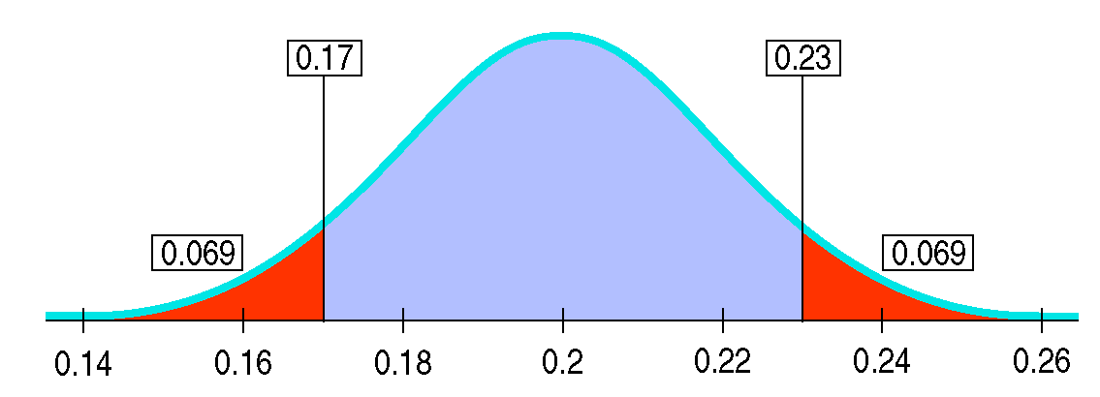
Alternative Alternatives (cont.)
H_{A}: parameter ≠ value is known as a two-sided alternative because we are equally interested in deviations on either side of the null hypothesis value.
For two-sided alternatives, the P-value is the probability of deviating in either direction from the null hypothesis value.

Slide 23
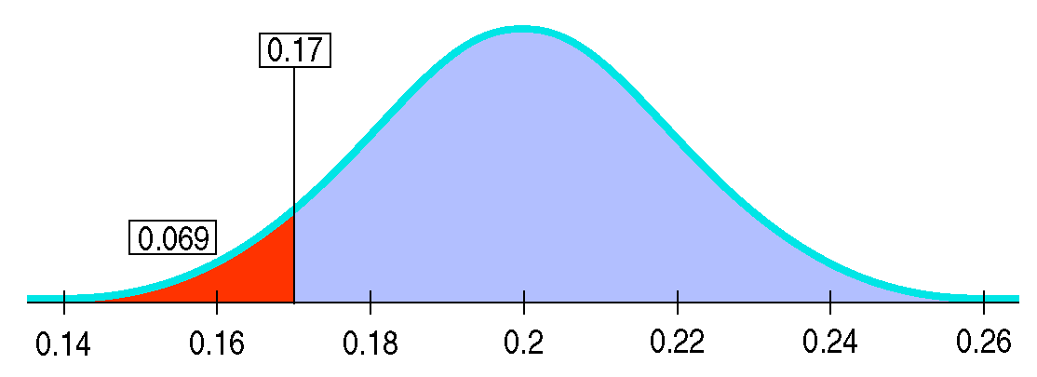
Alternative Alternatives (cont.)
The other two alternative hypotheses are called one-sided alternatives.
A one-sided alternative focuses on deviations from the null hypothesis value in only one direction.
Thus, the P-value for one-sided alternatives is the probability of deviating only in the direction of the alternative away from the null hypothesis value.

Slide 24
What Can Go Wrong? (cont.)
Don’t base your null hypothesis on what you see in the data.
Think about the situation you are investigating and develop your null hypothesis appropriately.
Don’t base your alternative hypothesis on the data, either.
Again, you need to Think about the situation.

Slide 25
What Can Go Wrong? (cont.)
Don’t make your null hypothesis what you want to show to be true.
You can reject the null hypothesis, but you can never “accept” or “prove” the null.
Don’t forget to check the conditions.
We need randomization, independence, and a sample that is large enough to justify the use of the Normal model.

Slide 26
What Can Go Wrong? (cont.)
Don’t accept the null hypothesis.
If you fail to reject the null hypothesis, don’t think a bigger sample would be more likely to lead to rejection.
Each sample is different, and a larger sample won’t necessarily duplicate your current observations.

