Slide 1
Chapter 2
Displaying & Describing Categorical Data

Slide 2
The power of a picture
When confused or in doubt,
Make a picture
Draw a diagram
Make a graph
Model it with representations
Many of us are visual learners, and it is EASIER to view and understand the data through one of the above pictures.
Always organize the data
Take the time to make a picture: it pays off in the end!

Slide 3
Counts vs. percentages
COUNTS: Numbered
PERCENTAGES: Proportion
“Counts” are just based on counting the amount when you make a pile (put items in categories).
This is the general term for using basic numbering to total categories for the categorical data.
Frequency tables simply count the amount each category occurs; therefore, the frequency is how often it occurs.
The counts converted to a fraction or proportion out of 100 to indicate the percent in which the category occurs.
This is referred to as the “relative frequency”
“Relative” tables and charts simply mean the categorical data is represented by percentages of the total.

Slide 4
COUNTS VS. PERCENTAGES
Frequency Table: COUNTS
Relative Frequency Table: PERCENTAGES

Slide 5
Categorical data displays
CATEGORICAL DISPLAYS can only be for categorical variables/data.
The displays can be based on counts or percentages.
Standard Bar Chart
Standard Pie Chart

Slide 6
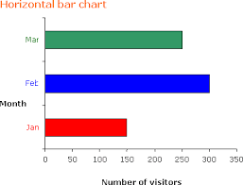
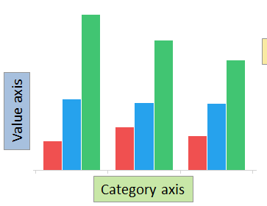
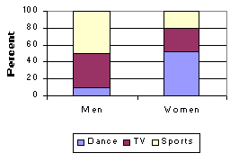
The variations of bar charts
BARS ONLY TOUCH IN THE SIDE-BY-SIDE SINCE THEY REPRESENT THE SAME CATEGORY. Otherwise, you must leave equal space between categories.
Horizontal
Side-by-Side
Segmented
Different Orientation to Show Growth
Used to show differences in groups
(gender, grade level, ethnicity, etc.)
Used to separate groups and show their categories/percentages within that group

Slide 7
Labeling displays
Your categorical display should always have:
Category axis (labeled by title and categories)
Frequency axis (labeled by counts or percentages)
Key or legend (if space is lacking to identify categories or values)
Bar charts must have the same width of bars and the same space between categories.
Be aware of the area principle and Simpson’s paradox when making or examining displays.
Guidelines for ensuring you correctly represent categorical data.

Slide 8
Contingency tables
Shows how the individuals are distributed along each variable, contingent on the value of the other.
Shows the relationship between parts of the data to the whole category or group.
Can be in counts or percentages

Slide 9
Contingency tables
Marginal Distribution: based on the total of all the data.
The bottom row and the right column
Conditional Distribution: based on parts of the total.
May use one category’s total, not the data total
The distribution has “conditions” on it (one area of focus)
Distribution: the amount in a category
(How the data is distributed or divided)

Slide 10
Contingency tables
Marginal Distribution: amount alive out of total amount of people on the Titanic
711 out of 2201 = 32.3%
Conditional Distribution: amount alive out of first class
203 out of 325 = 62.5%

Slide 11
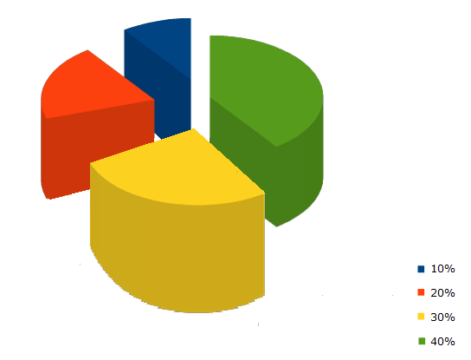
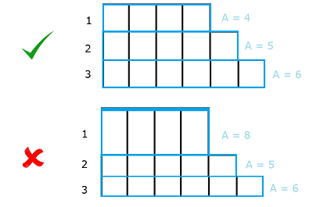
Obey the area principle
Each data value should be represented by the area corresponding to its value without distortion.

Slide 12
Obey the area principle

