Slide 1
Chapter 20
More about Tests and Intervals

Slide 2
Zero In on the Null
Null hypotheses have special requirements.
To perform a hypothesis test, the null must be a statement about the value of a parameter for a model.
We then use this value to compute the probability that the observed sample statistic—or something even farther from the null value—might occur.

Slide 3
Zero In on the Null (cont.)
How do we choose the null hypothesis? The appropriate null arises directly from the context of the problem—it is not dictated by the data, but instead by the situation.
One good way to identify both the null and alternative hypotheses is to think about the Why of the situation.
To write a null hypothesis, you can’t just choose any parameter value you like.
The null must relate to the question at hand—it is context dependent.

Slide 4
Zero In on the Null (cont.)
There is a temptation to state your claim as the null hypothesis.
However, you cannot prove a null hypothesis true.
So, it makes more sense to use what you want to show as the alternative.
This way, when you reject the null, you are left with what you want to show.

Slide 5
How to Think About P-Values
A P-value is a conditional probability—the probability of the observed statistic given that the null hypothesis is true.
The P-value is NOT the probability that the null hypothesis is true.
It’s not even the conditional probability that null hypothesis is true given the data.
Be careful to interpret the P-value correctly.

Slide 6
What to Do with a High P-Value
When we see a small P-value, we could continue to believe the null hypothesis and conclude that we just witnessed a rare event. But instead, we trust the data and use it as evidence to reject the null hypothesis.
However big P-values just mean what we observed isn’t surprising. That is, the results are now in line with our assumption that the null hypothesis models the world, so we have no reason to reject it.
A big P-value doesn’t prove that the null hypothesis is true, but it certainly offers no evidence that it is not true.
Thus, when we see a large P-value, all we can say is that we “don’t reject the null hypothesis.”

Slide 7
Alpha Levels
Sometimes we need to make a firm decision about whether or not to reject the null hypothesis.
When the P-value is small, it tells us that our data are rare given the null hypothesis.
How rare is “rare”?

Slide 8
Alpha Levels (cont.)
We can define “rare event” arbitrarily by setting a threshold for our P-value.
If our P-value falls below that point, we’ll reject H₀. We call such results statistically significant.
The threshold is called an alpha level, denoted by α.

Slide 9
Alpha Levels (cont.)
Common alpha levels are 0.10, 0.05, and 0.01.
You have the option—almost the obligation—to consider your alpha level carefully and choose an appropriate one for the situation.
The alpha level is also called the significance level.
When we reject the null hypothesis, we say that the test is “significant at that level.”

Slide 10
Alpha Levels (cont.)
What can you say if the P-value does not fall below α?
You should say that “The data have failed to provide sufficient evidence to reject the null hypothesis.”
Don’t say that you “accept the null hypothesis.”

Slide 11
Alpha Levels (cont.)
Recall that, in a jury trial, if we do not find the defendant guilty, we say the defendant is “not guilty”—we don’t say that the defendant is “innocent.”

Slide 12
Alpha Levels (cont.)
The P-value gives the reader far more information than just stating that you reject or fail to reject the null.
In fact, by providing a P-value to the reader, you allow that person to make his or her own decisions about the test.
What you consider to be statistically significant might not be the same as what someone else considers statistically significant.
There is more than one alpha level that can be used, but each test will give only one P-value.

Slide 13
Significant vs. Important
What do we mean when we say that a test is statistically significant?
All we mean is that the test statistic had a P-value lower than our alpha level.
However, don’t be lulled into thinking that statistical significance carries with it any sense of practical importance or impact, necessarily.

Slide 14
Significant vs. Important (cont.)
For large samples, even small, unimportant (“insignificant”) deviations from the null hypothesis can be statistically significant.
On the other hand, if the sample is not large enough, even large, financially or scientifically “significant” differences may not be statistically significant.
It’s good practice to report the magnitude of the difference between the observed statistic value and the null hypothesis value (in the data units) along with the P-value on which we base statistical significance.

Slide 15
Confidence Intervals and Hypothesis Tests
Confidence intervals and hypothesis tests are built from the same calculations.
They have the same assumptions and conditions.
You can approximate a hypothesis test by examining a confidence interval.
Just ask whether the null hypothesis value is consistent with a confidence interval for the parameter at the corresponding confidence level.

Slide 16
Confidence Intervals and Hypothesis Tests (cont.)
Because confidence intervals are two-sided, they correspond to two-sided tests.
In general, a confidence interval with a confidence level of C% corresponds to a two-sided hypothesis test with an α-level of
100 – C%.

Slide 17
Confidence Intervals and Hypothesis Tests (cont.)
The relationship between confidence intervals and one-sided hypothesis tests is a little more complicated.
A confidence interval with a confidence level of C% corresponds to a one-sided hypothesis test with an α-level of ½(100 – C)%.

Slide 18
*A 95% Confidence Interval for Small Samples
When the Success/Failure Condition fails, all is not lost.
A simple adjustment to the calculation lets us make a confidence interval anyway.
All we do is add four phony observations, two successes and two failures.
So instead of we use the adjusted proportion

Slide 19
*A Better Confidence Interval for Proportions (cont.)
Now the adjusted interval is
The adjusted form gives better performance overall and works much better for proportions of 0 or 1.
It has the additional advantage that we no longer need to check the Success/Failure Condition.

Slide 20
Making Errors
Here’s some shocking news for you: nobody’s perfect. Even with lots of evidence we can still make the wrong decision.
When we perform a hypothesis test, we can make mistakes in two ways:
The null hypothesis is true, but we mistakenly reject it. (Type I error)
The null hypothesis is false, but we fail to reject it. (Type II error)

Slide 21
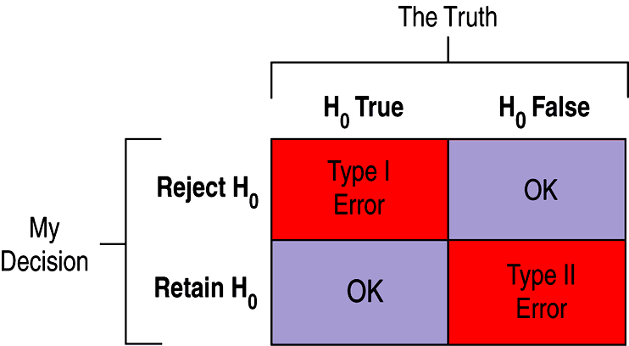
Making Errors (cont.)
Which type of error is more serious depends on the situation at hand. In other words, the gravity of the error is context dependent.
Here’s an illustration of the four situations in a hypothesis test:

Slide 22
Making Errors (cont.)
How often will a Type I error occur?
Since a Type I error is rejecting a true null hypothesis, the probability of a Type I error is our α level.
When H₀ is false and we reject it, we have done the right thing.
A test’s ability to detect a false hypothesis is called the power of the test.

Slide 23
Making Errors (cont.)
When H₀ is false and we fail to reject it, we have made a Type II error.
We assign the letter α to the probability of this mistake.
It’s harder to assess the value of α because we don’t know what the value of the parameter really is.
There is no single value for α—we can think of a whole collection of α’s, one for each incorrect parameter value.

Slide 24
Making Errors (cont.)
One way to focus our attention on a particular α is to think about the effect size.
Ask “How big a difference would matter?”
We could reduce α for all alternative parameter values by increasing α.
This would reduce α but increase the chance of a Type I error.
This tension between Type I and Type II errors is inevitable.

Slide 25
Power
The power of a test is the probability that it correctly rejects a false null hypothesis.
When the power is high, we can be confident that we’ve looked hard enough at the situation.
The power of a test is 1 – α ; because α is the probability that a test fails to reject a false null hypothesis and power is the probability that it does reject.

Slide 26
Power (cont.)
Whenever a study fails to reject its null hypothesis, the test’s power comes into question.
When we calculate power, we imagine that the null hypothesis is false.
The value of the power depends on how far the truth lies from the null hypothesis value.
The distance between the null hypothesis value, p₀, and the truth, p, is called the effect size.
Power depends directly on effect size.

Slide 27
A Picture Worth Words
The larger the effect size, the easier it should be to see it.
Obtaining a larger sample size decreases the probability of a Type II error, so it increases the power.
It also makes sense that the more we’re willing to accept a Type I error, the less likely we will be to make a Type II error.

Slide 28
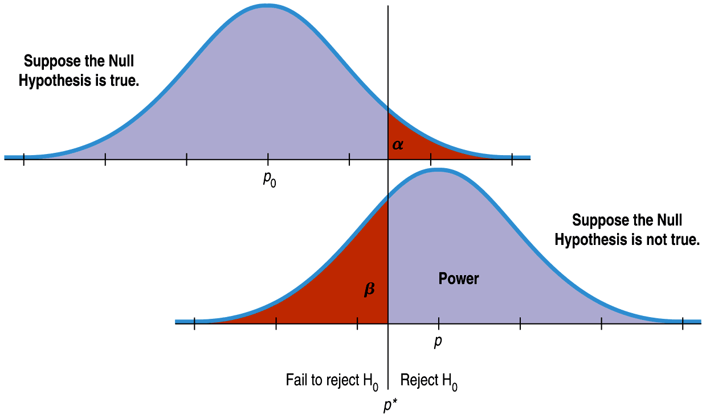
A Picture Worth Words (cont.)
This diagram shows the relationship between these concepts:

Slide 29
Reducing Both Type I and Type II Error
The previous figure seems to show that if we reduce Type I error, we must automatically increase Type II error.
But, we can reduce both types of error by making both curves narrower.
How do we make the curves narrower? Increase the sample size.

Slide 30
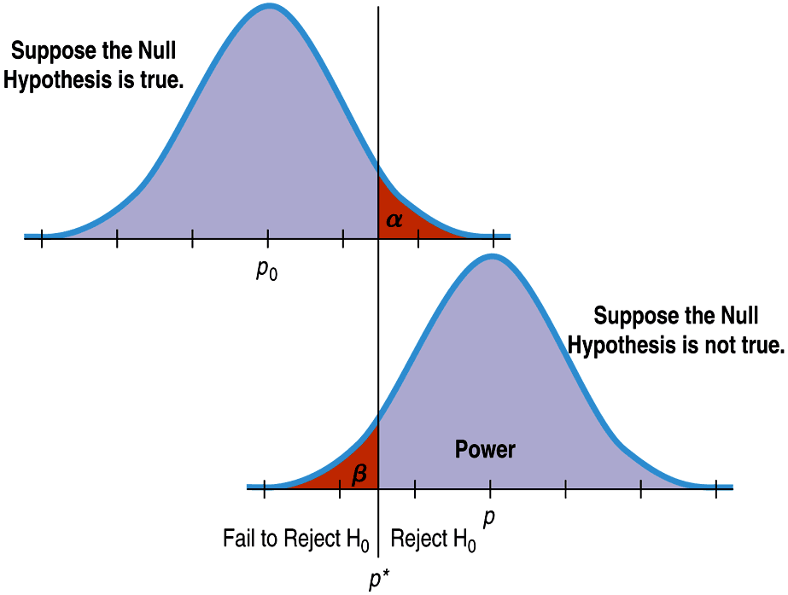
Reducing Both Type I and Type II Error (cont.)
This figure has means that are just as far apart as in the previous figure, but the sample sizes are larger, the standard deviations are smaller, and the error rates are reduced:

Slide 31
Reducing Both Type I and Type II Error (cont.)
Original comparison of errors:
Comparison of errors with a larger sample size:

Slide 32
What Can Go Wrong?
Don’t interpret the P-value as the probability that H₀ is true.
The P-value is about the data, not the hypothesis.
It’s the probability of observing data this unusual, given that H₀ is true, not the other way around.
Don’t believe too strongly in arbitrary alpha levels.
It’s better to report your P-value and a confidence interval so that the reader can make her/his own decision.

Slide 33
What Can Go Wrong? (cont.)
Don’t confuse practical and statistical significance.
Just because a test is statistically significant doesn’t mean that it is significant in practice.
And, sample size can impact your decision about a null hypothesis, making you miss an important difference or find an “insignificant” difference.
Don’t forget that in spite of all your care, you might make a wrong decision.

