Slide 1
Chapter 3 Quantitative Data
Parts 3 & 4
Support

Slide 2
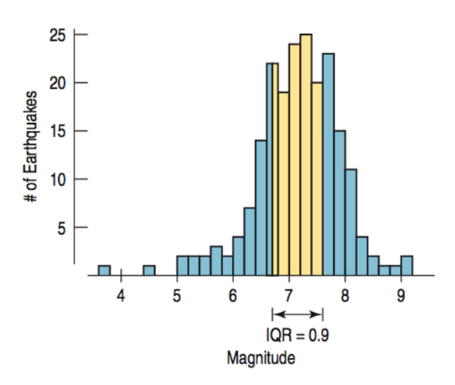
5-Number summary
Min – 0%
LQ (Q₁) – 25%
Med – 50%
UQ (Q₃)– 75%
Max – 100%
IQR = UQ – LQ (middle 50%)
The 5-number summary helps you build a boxplot.
It also helps you describe center and spread.

Slide 3
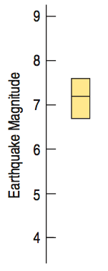
Constructing Boxplots
Draw a number line or axis for the data.
Mark the location of the LQ, Median, and UQ.
Make a box around the median.

Slide 4
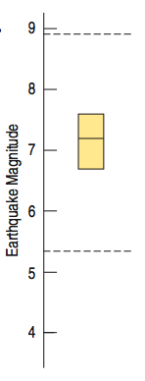
Constructing Boxplots (cont.)
4) Erect “fences” around the main part of the data.
The upper fence is 1.5 IQRs above the upper quartile.
UF = UQ + 1.5IQR
The lower fence is 1.5 IQRs below the lower quartile.
LF = LQ + 1.5IQR
Note: the fences only help with constructing the boxplot and should not appear in the final display.

Slide 5
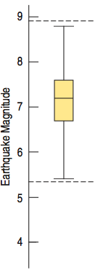
Constructing Boxplots (cont.)
5) Use the fences to grow “whiskers.”
Draw lines from the ends of the box up and down to the most extreme data values found within the fences.
If a data value falls outside one of the fences, we do not connect it with a whisker.
If the minimum and maximum fall within the fences, then we use them for the whiskers.

Slide 6
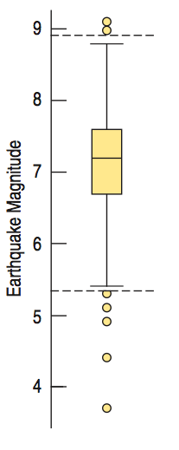
Constructing Boxplots (cont.)
6) Add the outliers by displaying any data values beyond the fences with special symbols.
We often use a different symbol for “far outliers” that are farther than 3 IQRs from the quartiles.
Depending on the boxplot, you can decide if you need to build the fences, or build the standard boxplot.

Slide 7
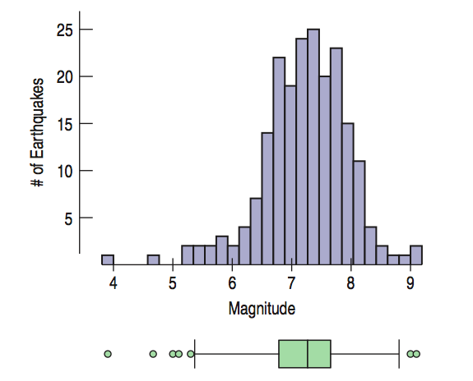
Wind Speed: Making Boxplots (cont.)
Compare the histogram and boxplot for daily wind speeds:
How does each display represent the distribution?

Slide 8
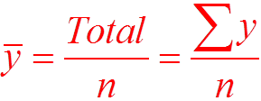
Mean Formula
When a bar is over a variable, it represents the mean.
The Greek letter Sigma means “sum” (add the values)
n represents the number of data values

Slide 9
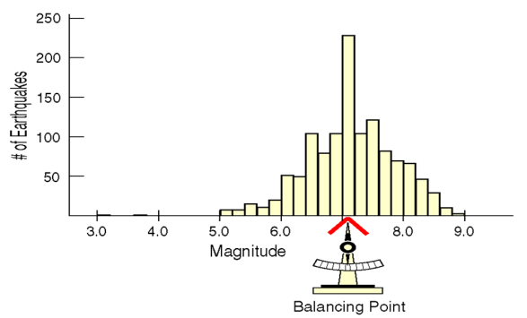
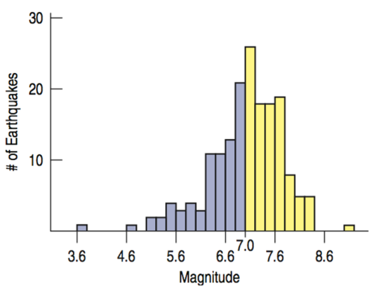
Describing Quantitative Displays
Center – where the heart of the data lies to divide the data in half (varies with skewed data)
Mean: average of the data (better if symmetric)
OR
Median: middle of the data (better if skewed)

Slide 10
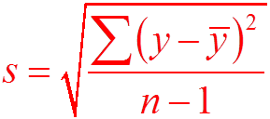
Describing Quantitative Displays
Spread – the range of the data
Clustered or spread out?
Range = Max – Min
Interquartile Range (IQR) = UQ – LQ
Standard Deviation =

Slide 11
Describing Quantitative Displays
Standard Deviation =
In your calculator, Sx is the standard deviation. Remember this tells you how much the data deviates (varies), on average, from the mean.

Slide 12
Describing Quantitative Displays
Spread – the range of the data
If the shape is skewed, report the median and IQR.
If the shape is symmetric, report the mean and standard deviation and possibly the median and IQR as well.

Slide 13
Describing Quantitative Displays
Spread – the range of the data
Deviation – the distance a value is from the mean. (how it compares, or deviates, from the mean)
Standard Deviation – the average of all the deviations to help determine the spread

Slide 14
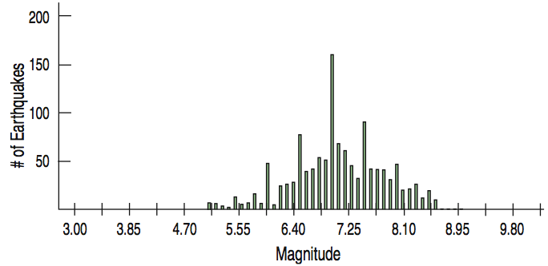
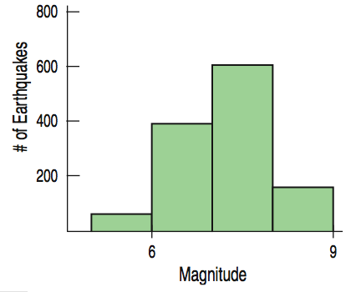
What Can Go Wrong?
Choose a bin width appropriate to the data.
Changing the bin width changes the appearance of the histogram:

Slide 15
What Can Go Wrong? (cont.)
Don’t forget to do a reality check – don’t let the calculator do the thinking for you.
Don’t forget to sort the values before finding the median or percentiles.
Don’t worry about small differences when using different methods.
Don’t compute numerical summaries of a categorical variable.
Don’t report too many decimal places.
Don’t round in the middle of a calculation.
Watch out for multiple modes
Beware of outliers
Make a picture … make a picture . . . make a picture !!!

