Slide 1
Ch 6 Part 1 Support
Scatterplots, Association, and Correlation

Slide 2
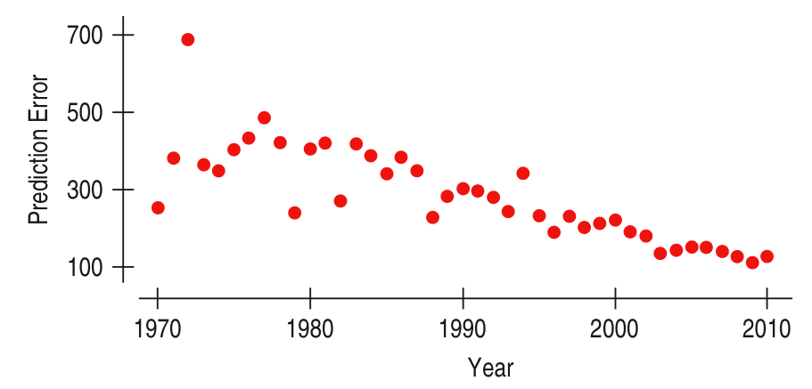
Scatterplots – Basic Information
Involves the relationship between two quantitative variables
Most common and most effective display for data
Good for patterns, trends, and relationships
Best way to observe the relationship, or association, between those two quantitative variables

Slide 3
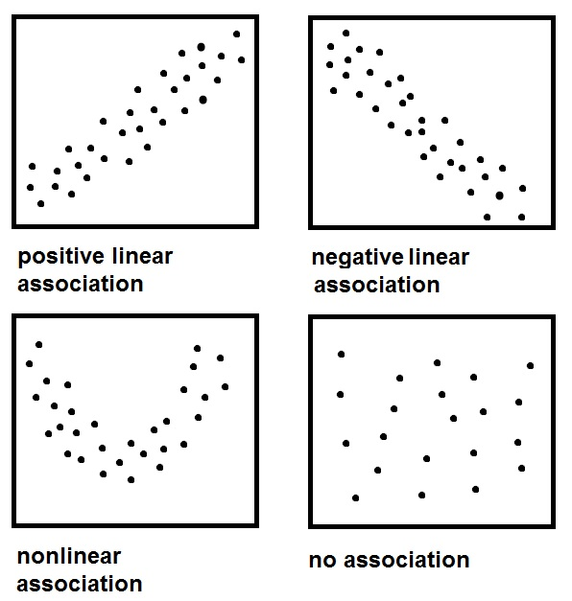
Describing Scatterplots
Similar to shape, center, and spread from Ch. 3, we can describe scatterplots based on certain qualities.
Direction – the way the points head
Positive – x and y increase
Negative – x and y decrease
Constant – horizontal (no increase or decrease)
No direction – scattered with no pattern

Slide 4
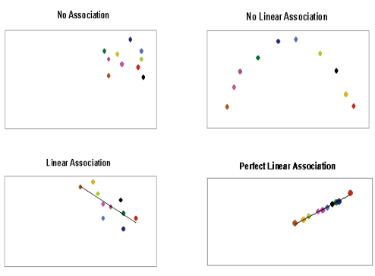
Describing Scatterplots
Similar to shape, center, and spread from Ch. 3, we can describe scatterplots based on certain qualities.
Form – the kind of relationship (shape)
Linear – line based patterns
Non-Linear – other shaped pattern
Parabolic
Exponential
Logarithmic

Slide 5
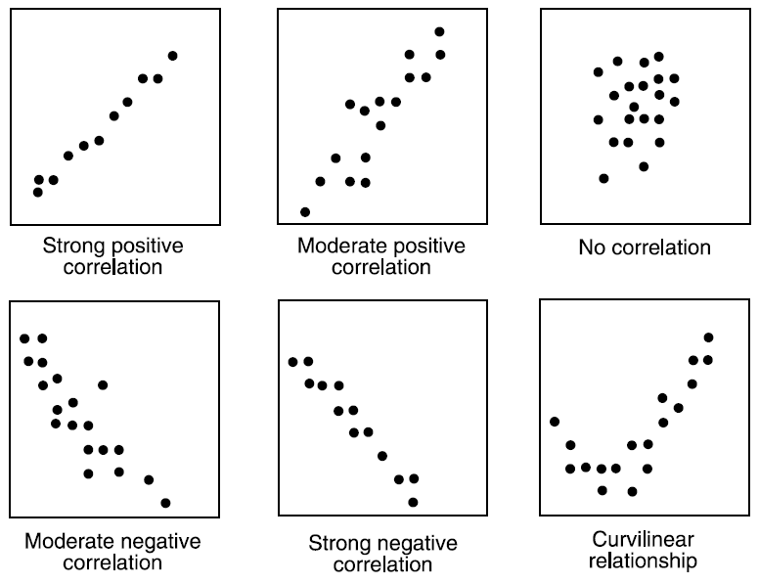
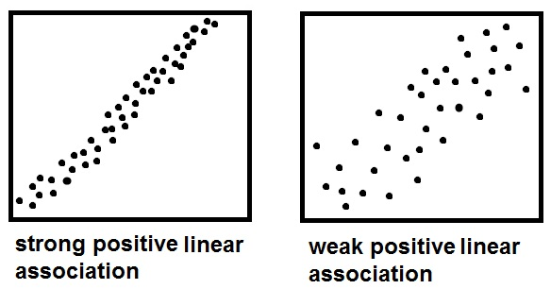
Describing Scatterplots
Similar to shape, center, and spread from Ch. 3, we can describe scatterplots based on certain qualities.
Strength – how close it fits or suits a form
Strong – points clustered close together to create a form
Moderate – somewhat clustered
Weak – less clustered

Slide 6
Describing Scatterplots
Similar to shape, center, and spread from Ch. 3, we can describe scatterplots based on certain qualities.
Unusual Features – outliers, etc.
Look for the unexpected.
Often the most interesting thing to see in a scatterplot is the thing you never thought to look for.
An outlier standing away from the overall pattern of the scatterplot.
Clusters or subgroups should also raise questions.

Slide 7
ROLES OF VARIABLES
Knowing which variable should be on the x-axis and which variable should be on the y-axis is decided by the role of each variable.
With two quantitative variables, both axes are numbered and relevant toward the data.
It is important to decide the role of each variable in order to create the more appropriate scatterplot.

Slide 8
Roles of Variables
EXPLANATORY VARIABLE
RESPONSE VARIABLE
Has other names
Predictor variable
Independent variable
Describe the x-variable
Explains or predicts the y-value
Has other names
Variable of Interest
Dependent variable
Describes the y-variable
Responds to the x-value

Slide 9
Correlation
Correlation – a statistical measure of how strong an association between two quantitative variables is.
Based on linear associations
Used to test or describe the strength in order to determine the intent behind their association
Draw conclusions
Determine relationship

Slide 10
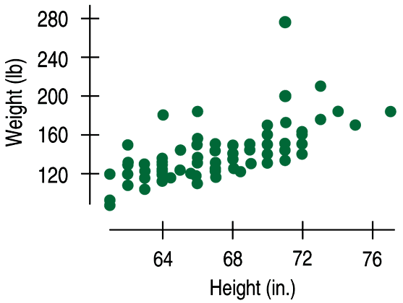
Correlation
Data collected from students in Statistics classes included their heights (in inches) and weights (in pounds):
Here we see a positive association and a fairly straight form, although there seems to be a high outlier.

Slide 11
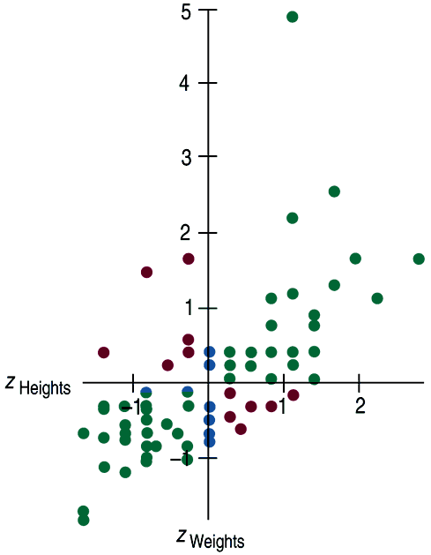
Correlation (cont.)
If the axes are numbered differently, you can take the z-scores of each data value to standardize the data.
This helps identify the direction, form, and strength with the axes the same.
Some points (those in green) strengthen the impression of a positive association between height and weight.
Other points (those in red) tend to weaken the positive association.
Points with z-scores ofzero (those in blue) don’t vote either way.

Slide 12
Correlation (cont.)
The correlation coefficient (r) gives us a numerical measurement of the strength of the linear relationship between the explanatory and response variables.

Slide 13
Understanding the Correlation Coefficient
For the students’ heights and weights, the correlation is 0.644. (r value)
What does this mean?
The sign is positive, so it tells us there is a positive association.
0.644 is moderate in strength.
So we say a correlation of 0.644 tells us there is a positive, moderate, linear relationship between height and weight.
Of course, we’d also like to see a scatterplot!
Notes:
Do not spend time calculating this value by hand!

Slide 14
Correlation Conditions
Correlation measures the strength of the linear association between two quantitative variables.
Before you use correlation, you must check several conditions:
Quantitative Variables Condition
Straight Enough Condition
Outlier Condition

Slide 15
Correlation Conditions (cont.)
Quantitative Variables Condition:
Correlation applies only to quantitative variables.
Don’t apply correlation to categorical data to categorical variables.
Check that you know the variables’ units and what they measure.

Slide 16
Correlation Conditions (cont.)
Straight Enough Condition:
Correlation measures the strength only of the linear association, and will be misleading if the relationship is not linear.
Thus we only calculate and use the correlation coefficient for linear data.

Slide 17
Correlation Conditions (cont.)
Outlier Condition:
Outliers can distort the correlation dramatically.
An outlier can make an otherwise small correlation look big or hide a large correlation.
It can even give an otherwise positive association a negative correlation coefficient (and vice versa).
When you see an outlier, it’s often a good idea to report the correlations with and without the point.

