Slide 1
Ch. 7 Part 1 Support
Linear Regression

Slide 2
Connection to Chapter 6
We will continue exploring the relationship between two quantitative variables through scatterplots in Chapter 7.
We will focus on the line of best fit.
Also known as:
Trend Line
Linear Model
Correlation line
Linear Regression Model

Slide 3
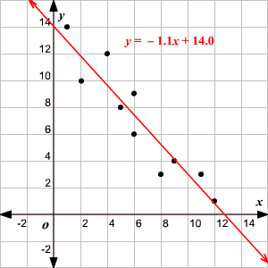
Ch 7 Linear Regression
A line of best fit (or "trend" line) is a straight line that best represents the data on a scatter plot.
This line may pass through some of the points, none of the points, or all of the points.

Slide 4
The Regression Line in Real Units
Remember from Algebra that a straight line can be written as:
In Statistics we use a slightly different notation:
We write to emphasize that the points that satisfy this equation are just our predicted values, not the actual data values.
This model says that our predictions from our model follow a straight line.
If the model is a good one, the data values will scatter closely around it.

Slide 5
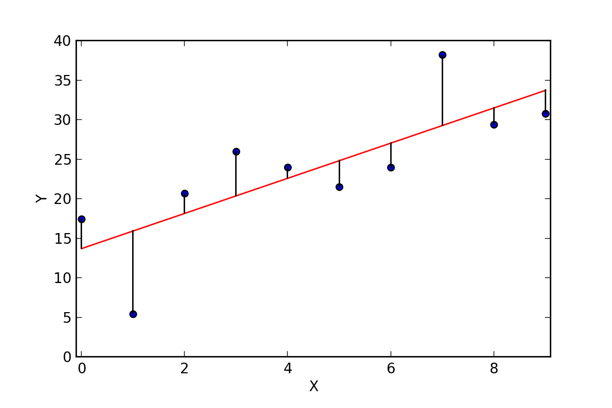
Residuals
The model won’t be perfect, regardless of the line we draw.
As George Box said “All models are wrong, but some models are useful.”
Some points will be above the line and some will be below.
The estimate made from a model is the predicted value (denoted as ).

Slide 6
Residuals (cont.)
The difference between the observed value and its associated predicted value is called the residual.
To find the residuals, we always subtract the predicted value from the observed one:

Slide 7
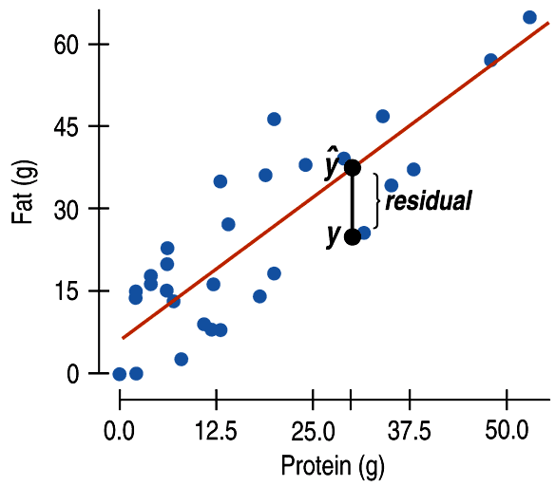
Residuals (cont.)
A negative residual means the predicted value’s too big (an overestimate).
A positive residual means the predicted value’s too small (an underestimate).
In the figure, the estimated fat of the BK Broiler chicken sandwich is 36 g, while the true value of fat is 25 g, so the residual is –11 g of fat.

Slide 8
“Best Fit” Means Least Squares
Some residuals are positive, others are negative, and, on average, they cancel each other out.
So, we can’t assess how well the line fits by adding up all the residuals.
Similar to what we did with deviations, we square the residuals and add the squares.
The smaller the sum, the better the fit.
The line of best fit is the line for which the sum of the squared residuals is smallest, the least squares line.

Slide 9
How Big Can Predicted Values Get?
r cannot be bigger than 1 (in absolute value), so each predicted y tends to be closer to its mean (in standard deviations) than its corresponding x was.
This property of the linear model is called regression to the mean; the line is called the regression line.

Slide 10
The Regression Line in Real Units(cont.)
We write b₁ and b₀ for the slope and intercept of the line.
b₁ is the slope, which tells us how rapidly changes with respect to x.
b₀ is the y-intercept, which tells where the line crosses (intercepts) the y-axis.

Slide 11
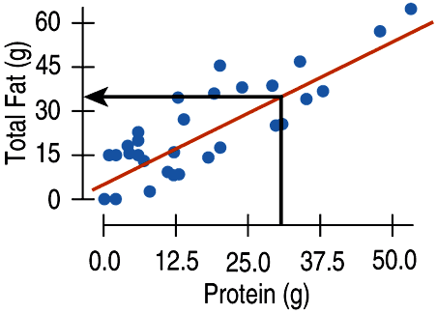
Fat Versus Protein: An Example
The regression line for the Burger King data fits the data well:
The equation is
The predicted fat content for a BK Broiler chicken sandwich (with 30 g of protein) is 6.8 + 0.97(30) = 35.9 grams of fat.

Slide 12
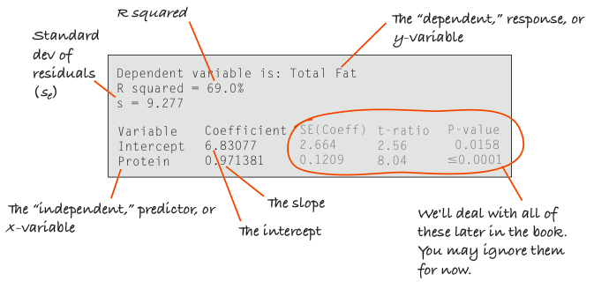
Computer regression

