Slide 1
Ch 7 Part 2 & 3 Support
Linear Regression

Slide 2
Residuals
Remember, residuals describe the difference between the observed value and the predicted value on the line of best fit.
It is designed to determine how well the model suits the data.
Residual Plots can help you determine the effectiveness of the linear regression model.

Slide 3
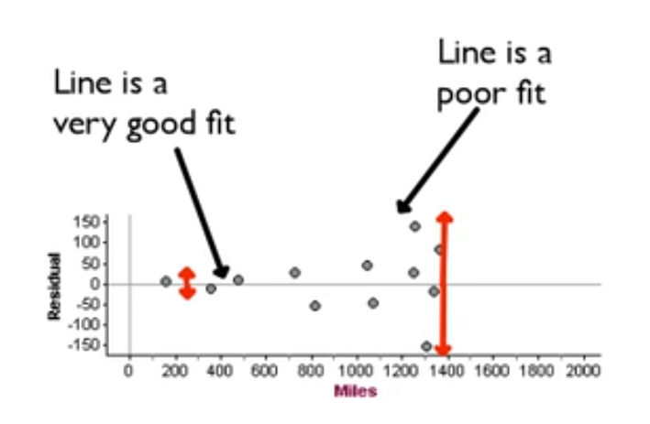
Residual Plot

Slide 4
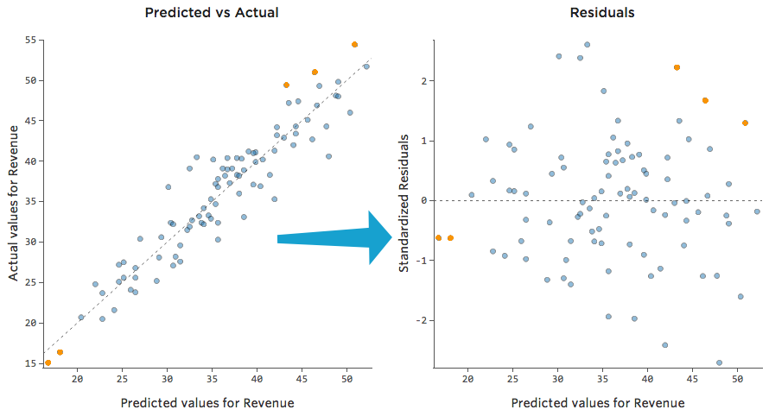
Residuals

Slide 5
Residuals Revisited
The linear model assumes that the relationship between the two variables is a perfect straight line. The residuals are the part of the data that hasn’t been modeled.
Data = Model + Residual
or (equivalently)
Residual = Data – Model
Or, in symbols,

Slide 6
Residuals Revisited (cont.)
Residuals help us to see whether the model makes sense.
When a regression model is appropriate, nothing interesting should be left behind.
After we fit a regression model, we usually plot the residuals in the hope of finding…nothing.

Slide 7
R²—The Variation Accounted For (cont.)
If the correlation were 1.0 and the model predicted the fat values perfectly, the residuals would all be zero and have no variation.
As it is, the correlation is 0.83—not perfection.
However, we did see that the model residuals had less variation than total fat alone.
We can determine how much of the variation is accounted for by the model and how much is left in the residuals.

Slide 8
R²—The Variation Accounted For (cont.)
The squared correlation, r², gives the fraction of the data’s variance accounted for by the model.
Thus, 1 – r² is the fraction of the original variance left in the residuals.
For the BK model, r² = 0.83² = 0.69, so 31% of the variability in total fat has been left in the residuals.

Slide 9
R²—The Variation Accounted For (cont.)
All regression analyses include this statistic, although by tradition, it is written R² (pronounced “R-squared”).
An R² of 0 means that none of the variance in the data is in the model; all of it is still in the residuals.
When interpreting a regression model you need to Tell what R² means.
In the BK example, 69% of the variation in total fat is accounted for by variation in the protein content.

Slide 10
How Big Should R² Be?
R² is always between 0% and 100%.
What makes a “good” R² value depends on the kind of data you are analyzing and on what you want to do with it.
The standard deviation of the residuals can give us more information about the usefulness of the regression by telling us how much scatter there is around the line.

Slide 11
Reporting R²
Along with the slope and intercept for a regression, you should always report R² so that readers can judge for themselves how successful the regression is at fitting the data.
Statistics is about variation, and R² measures the success of the regression model in terms of the fraction of the variation of y accounted for by the regression.

Slide 12
Assumptions and Conditions
Quantitative Variables Condition:
Regression can only be done on two quantitative variables (and not two categorical variables), so make sure to check this condition.
Straight Enough Condition:
The linear model assumes that the relationship between the variables is linear.
A scatterplot will let you check that the assumption is reasonable.

Slide 13
Assumptions and Conditions (cont.)
It’s a good idea to check linearity again after computing the regression when we can examine the residuals.
Does the Plot Thicken? Condition:
Look at the residual plot -- for the standard deviation of the residuals to summarize the scatter, the residuals should share the same spread. Check for changing spread in the residual scatterplot.

Slide 14
Assumptions and Conditions (cont.)
Outlier Condition:
Watch out for outliers.
Outlying points can dramatically change a regression model.
Outliers can even change the sign of the slope, misleading us about the underlying relationship between the variables.
If the data seem to clump or cluster in the scatterplot, that could be a sign of trouble worth looking into further.

Slide 15
What Can Go Wrong?
Don’t fit a straight line to a nonlinear relationship.
Beware extraordinary points (y-values that stand off from the linear pattern or extreme x-values).
Don’t extrapolate beyond the data—the linear model may no longer hold outside of the range of the data.
Don’t infer that x causes y just because there is a good linear model for their relationship—association is not causation.
Don’t choose a model based on R² alone.

