Slide 1
2.1 For Real?
Sample Surveys, Observational Studies, and Experiments

Slide 3
Let’s review what we’ve covered…
What is the Empirical rule for normal distributions?
What is a z-score?
How is a z-score calculated?
What is a percentile?
How do you determine a percentile?
How do you determine the probability of a given data value within a normal distribution?

Slide 4
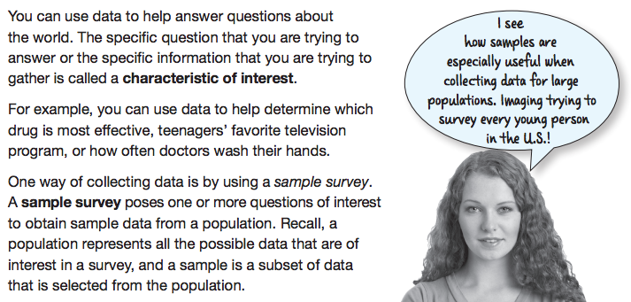

Slide 6
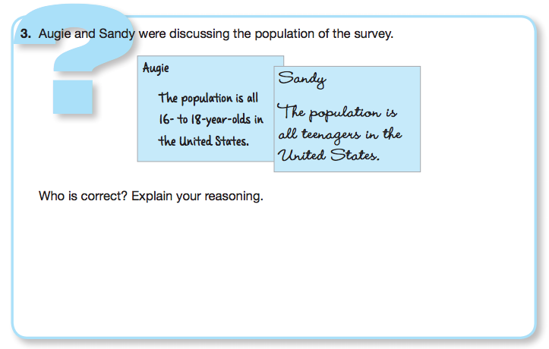

Slide 9
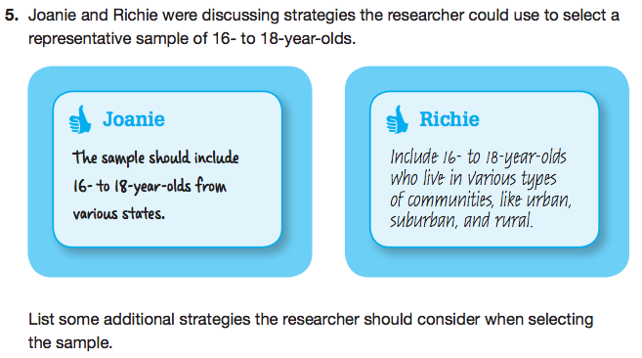
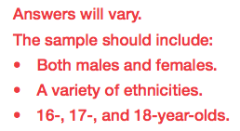

Slide 14
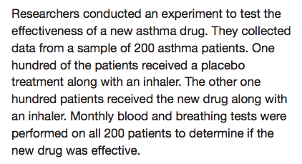

Slide 18
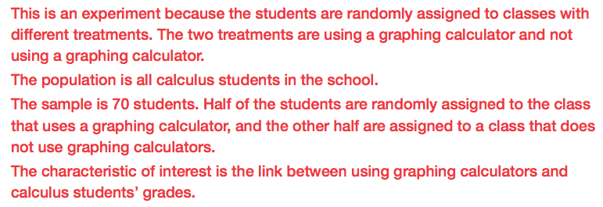

Slide 24
Let’s review what we’ve covered…
What is a characteristic of interest?
What is a sample survey?
What is a random sample?
What is a biased sample?
What is an observational study?
What is an experiment?
What is a treatment?
What is an experimental unit?
What is confounding?

Slide 25
Mathia time Keep your notes and Mathia notebook out.

