Slide 1
2.2 Circle Up
Sampling Methods and Randomization

Slide 3
Let’s review what we’ve covered…
What is a characteristic of interest?
What is a sample survey?
What is a random sample?
What is a biased sample?
What is an observational study?
What is an experiment?
What is a treatment?
What is an experimental unit?
What is confounding?

Slide 7
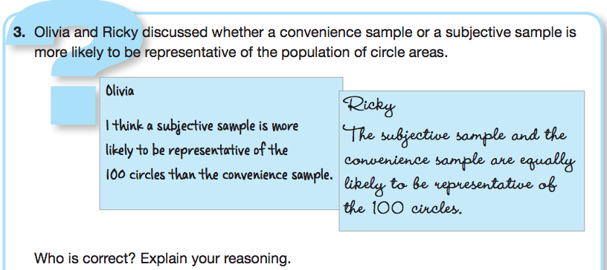

Slide 10
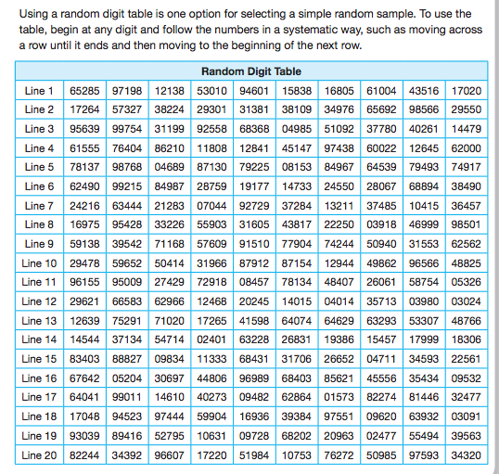

Slide 14
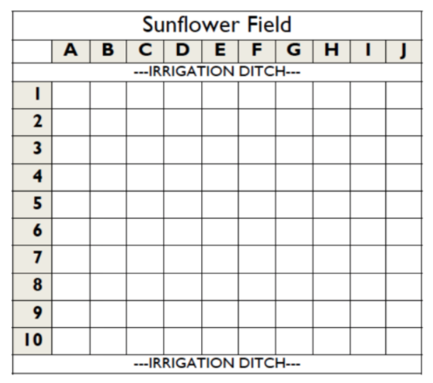

Slide 19
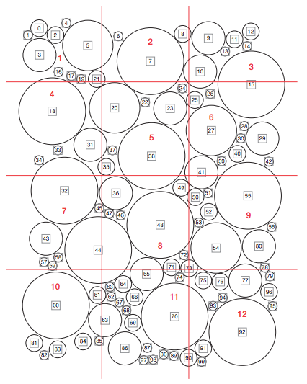

Slide 22
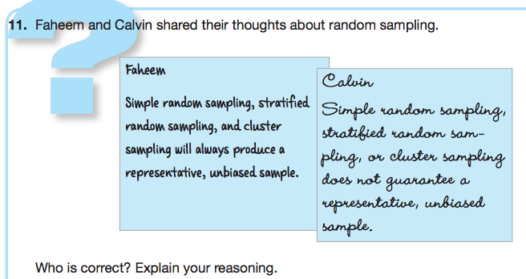

Slide 24
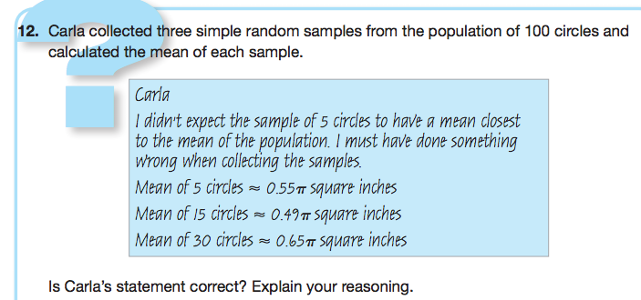

Slide 25
Let’s review what we’ve covered…
What is a convenience sample?
What is a subjective sample?
What is a volunteer sample?
What is a simple random sample?
What is a stratified random sample?
What is a cluster and a cluster sample?
What is a systematic sample?
What is the difference between a parameter and a statistic?

Slide 26
Mathia time Keep your notes and Mathia notebook out.

