Slide 1
2.3 Sleep Tight
Using Confidence Intervals to Estimate Unknown Population Means

Slide 3
Let’s review what we’ve covered…
What is a convenience sample?
What is a subjective sample?
What is a volunteer sample?
What is a simple random sample?
What is a stratified random sample?
What is a cluster and a cluster sample?
What is a systematic sample?
What is the difference between a parameter and a statistic?

Slide 6
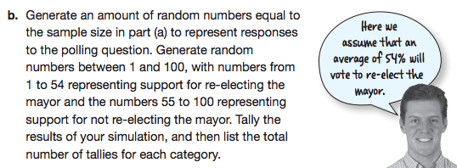
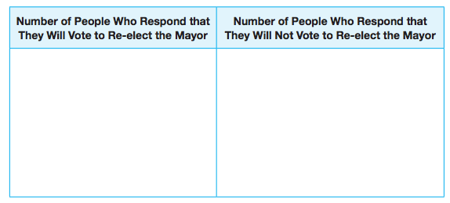

Slide 11
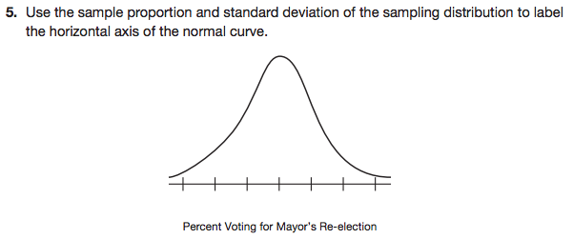
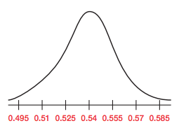

Slide 12
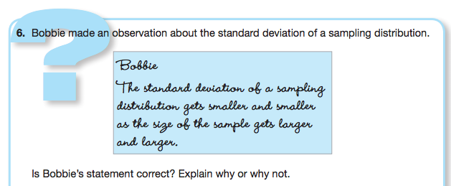
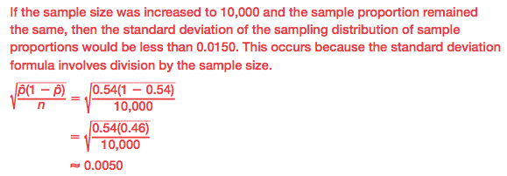

Slide 13
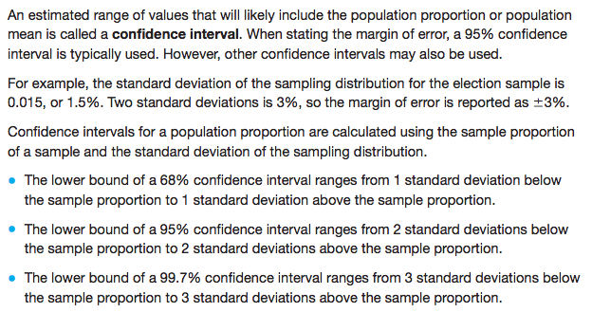

Slide 14
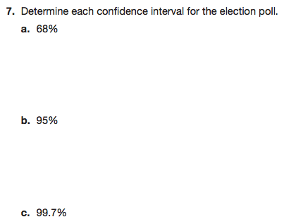

Slide 19
Let’s review what we’ve covered THUS far…
What is a population proportion?
What is a sample proportion?
What is a sampling distribution?
What is the formula to calculate the standard deviation of a sampling distribution?
What is a confidence interval?
What is a 68% confidence interval?
What is a 95% confidence interval?
What is a 99.7% confidence interval?

Slide 29
Let’s review what we’ve covered…
What is a characteristic of interest?
What is a sample survey?
What is a random sample?
What is a biased sample?
What is an observational study?
What is an experiment?
What is a treatment?
What is an experimental unit?
What is confounding?

Slide 30
Mathia time Keep your notes and Mathia notebook out.

