Slide 1
2.4 How Much Different?
Using Statistical Significance to MakeInferences About Populations

Slide 3
Let’s review…
What is a population proportion?
What is a sample proportion?
What is a sampling distribution?
What is the formula to calculate the standard deviation of a sampling distribution from discrete data?
What is a confidence interval?
What is a 68%, 95% and 99.7% confidence interval?
What is the formula to calculate the standard deviation of a sampling distribution for continuous data?

Slide 6
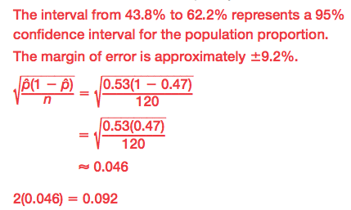

Slide 7
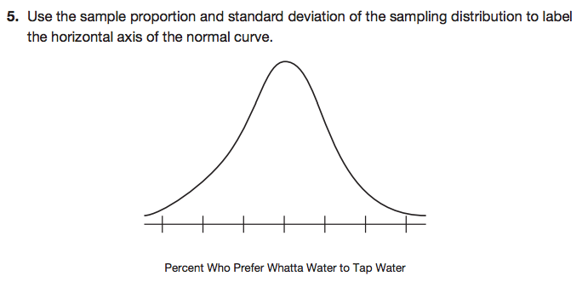
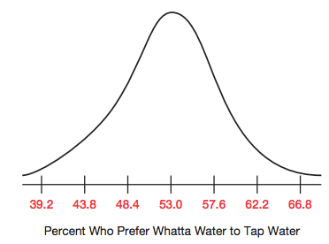

Slide 8
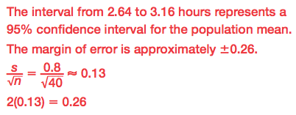

Slide 9
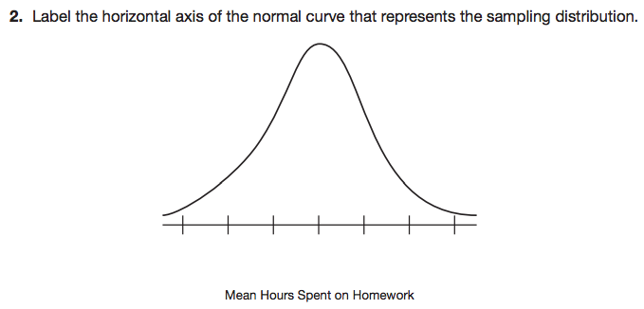
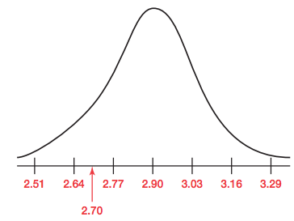

Slide 10
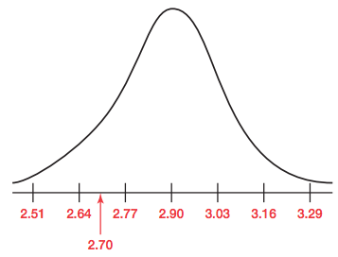

Slide 12
Let’s review what we’ve covered THUS far…
What is a sample proportion?
What is a sample mean?
What does statistically significant mean?

Slide 13
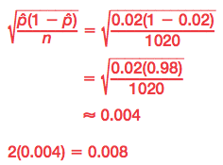

Slide 15
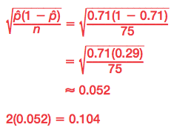

Slide 16
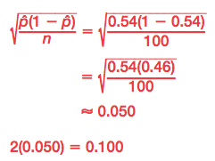

Slide 17
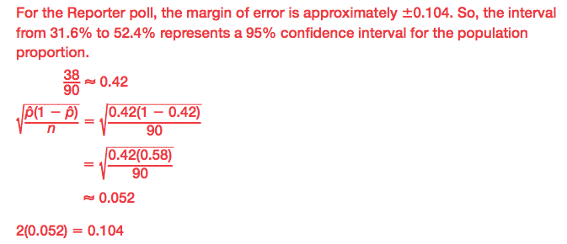

Slide 20
Let’s review what we’ve covered…
What is a sample proportion?
What is a sample mean?
What does statistically significant mean?
When comparing multiple sets of data, how do you determine if the results are statically significant?

Slide 21
Mathia time Keep your notes and Mathia notebook out.

