Slide 1
Chapter 01
Stats Starts Here

Slide 2
Stats Starts Here
Statistics gets no respect, and
Statistics courses are not necessarily chosen as fun electives, but
Statistics can be fun! Learning to think clearly with data will open your eyes to seeing the world more clearly…

Slide 3
What Is (Are?) Statistics?
Statistics (the discipline) is a way of reasoning, along with collection of tools and methods, designed to help us understand the world.
Statistics (plural) are particular calculations made from data. For example, the mean and the median are statistics.
Data are values with a context.

Slide 4
What is Statistics Really About?
Statistics is about variation.
People have different opinions about important issues. It can be important to see how their answers vary.
When we take measurements in an experiment, we expect individuals to be slightly different. How much difference is simply due to random variation? And when is a difference so large that we believe something other than random variation is at work?

Slide 5
Think, Show, Tell
There are three simple steps to doing Statistics right:
first. Know where you’re headed and why.
is about the mechanics of calculating statistics and making graphical displays, which are important (but are not the most important part of Statistics).
what you’ve learned. You must explain your results so that someone else can understand your conclusions.

Slide 6
What Are Data?
Data can be numbers, record names, or other labels.
Not all data represented by numbers are numerical data (e.g., 1 = male, 2 = female).
Data are useless without their context…

Slide 7
The “W’s”
To provide context we need the W’s
Who
What (and in what units)
When
Where
Why (if possible)
and How
of the data.
Note: the answers to “who” and “what” are essential.
Note: Unit III will be devoted to How we collect data.

Slide 8
Data Tables
The following data table clearly shows the context of the data presented:
Notice that this data table tells us the What (column) and Who (row) for these data.

Slide 9
Who
The Who of the data tells us the individual cases for which (or whom) we have collected data.
Individuals who answer a survey are called respondents.
People on whom we experiment are called subjects or participants.
Animals, plants, and inanimate subjects are called experimental units.

Slide 10
Who (cont.)
Sometimes people just refer to data values as observations and are not clear about the Who.
But we need to know the Who of the data so we can learn what the data say.
In this course, we will discuss data collected from many different individuals. For example,
Students at your school
The 50 fastest roller coasters
Tomato plants

Slide 11
What and Why
Variables are characteristics recorded about each individual.
The variables should have a name that identify What has been measured.
To understand variables, you must Think about what you want to know.

Slide 12
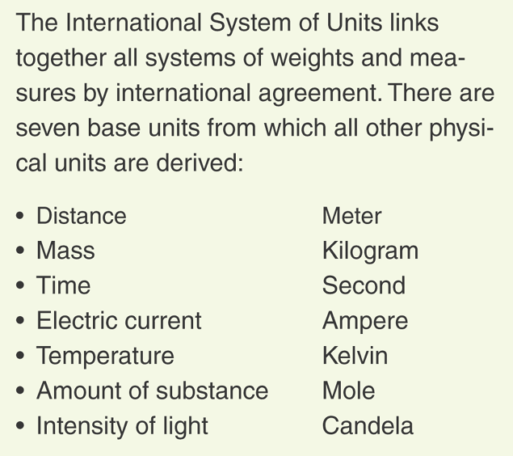
What and Why (cont.)
Some variables have units that tell how each value has been measured and tell the scale of the measurement.

Slide 13
What and Why (cont.)
A categorical variable names categories and answers questions about how cases fall into those categories.
Categorical examples: sex, race, ethnicity
A quantitative variable is a measured variable (with units) that answers questions about the quantity of what is being measured.
Quantitative examples: income ($), height (inches), weight (pounds)

Slide 14
What and Why (cont.)
The questions we ask a variable (the Why of our analysis) shape what we think about and how we treat the variable.

Slide 15
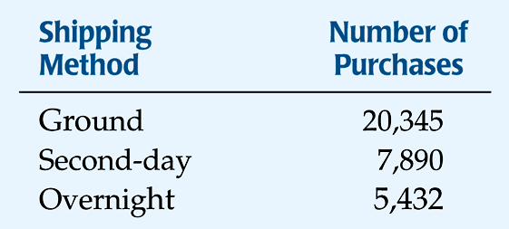
Counts Count
We usually use a frequency table for categorical variables.
For example, here is a frequency table for the question “What shipping method was chosen?”

Slide 16
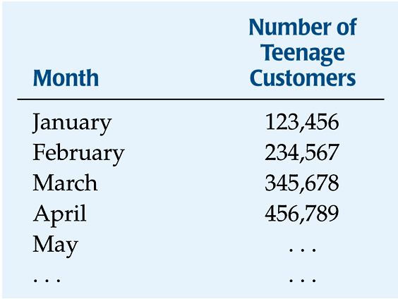
Counts Count (cont.)
When we focus on the amount of something, we use counts differently. For example, Amazon might track the growth in the number of teenage customers each month to forecast CD sales (the Why).
The What is teens, the Who is months, and the units are number of teenage customers.

Slide 17
Quantities
Student | # of AP Exams
Doug | 2
Carl | 4
Erica | 7
Deanna | 8
Jason | 1
Corey | 0
Michael | 3
Paul | 4
Adam | 5
When the values you want to study are quantities, you are examining a quantitative variable.
For example, the question “How many AP tests will you take?” is a quantitative variable.

Slide 18
Quantities
Catapult | Distance (cm)
A | 67
B | 55
C | 79
D | 112
E | 13
F | 98
G | 137
H | 67
I | 178
Another example of a quantitative variable is the question “How far did the catapult throw the soup can?”.

Slide 19
Identifying Identifiers
Identifier variables are categorical variables with exactly one individual in each category.
Examples: Social Security Number, ISBN, FedEx Tracking Number
Don’t analyze identifier variables.
Be careful not to consider all variables with one case per category, like year or name, as identifier variables.
The Why will help you decide how to treat identifier variables.

Slide 20
Where, When, and How
We need the Who, What, and Why to analyze data. But, the more we know, the more we understand.
When and Where give us some nice information about the context.
Example: Values recorded at a large public university may mean something different than similar values recorded at a small private college.

Slide 21
Where, When, and How (cont.)
How the data are collected can make the difference between insight and nonsense.
Example: Results from Internet surveys are often useless.
In Unit III we will study How to collect data carefully.
The first step of any data analysis should be to examine the W’s—this is a key part of the Think step of any analysis.

Slide 22
What Can Go Wrong?
Don’t label a variable as categorical or quantitative without thinking about the question you want it to answer.
Just because your variable’s values are numbers, don’t assume that it’s quantitative (i.e., think about jersey numbers or zip codes).
Always be skeptical—don’t take data for granted.

Slide 23
What have we learned?
Statistics is about data
It helps us understand the world.
We seek to describe how much data varies.
Data are information in a context.
The W’s help with context.
We must know the Who (cases), What (variables), and Why to be able to say anything useful about the data.

Slide 24
What have we learned? (cont.)
We treat variables as categorical or quantitative.
Categorical variables identify a category for each case.
Quantitative variables record measurements or amounts of something and must have units.

Slide 25
AP Tips
When reading an AP free response question, you will often first need to decide if the data is categorical or quantitative. If you make the wrong decision at the outset, you will probably earn a zero on the rubric!
In the next few chapters, you will be graphing both types of variables. Make sure you keep the two types of graphs clear in your mind. Again, making the right choice makes the difference between some credit and NO credit.

