Slide 1
Chapter 2
Displaying and Describing Categorical Data

Slide 2
The Three Rules of Data Analysis
The three rules of data analysis won’t be difficult to remember:
Make a picture—things may be revealed that are not obvious in the raw data. These will be things to think about.
Make a picture—important features of and patterns in the data will show up. You may also see things that you did not expect.
Make a picture—the best way to tell others about your data is with a well-chosen picture.

Slide 3
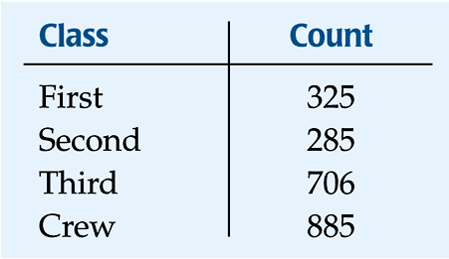
Frequency Tables: Making Piles
We can “pile” the data by counting the number of data values in each category of interest.
We can organize these counts into a frequency table, which records the totals and the category names.

Slide 4
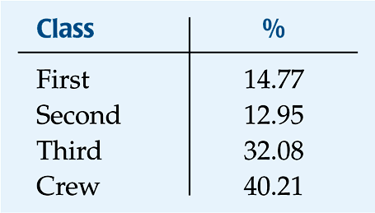
Frequency Tables: Making Piles (cont.)
A relative frequency table is similar, but gives the percentages (instead of counts) for each category.

Slide 5
Frequency Tables: Making Piles (cont.)
Both types of tables show how cases are distributed across the categories.
They describe the distribution of a categorical variable because they name the possible categories and tell how frequently each occurs.
Pro-tip: relative frequency is just a fancy name for percent.

Slide 6
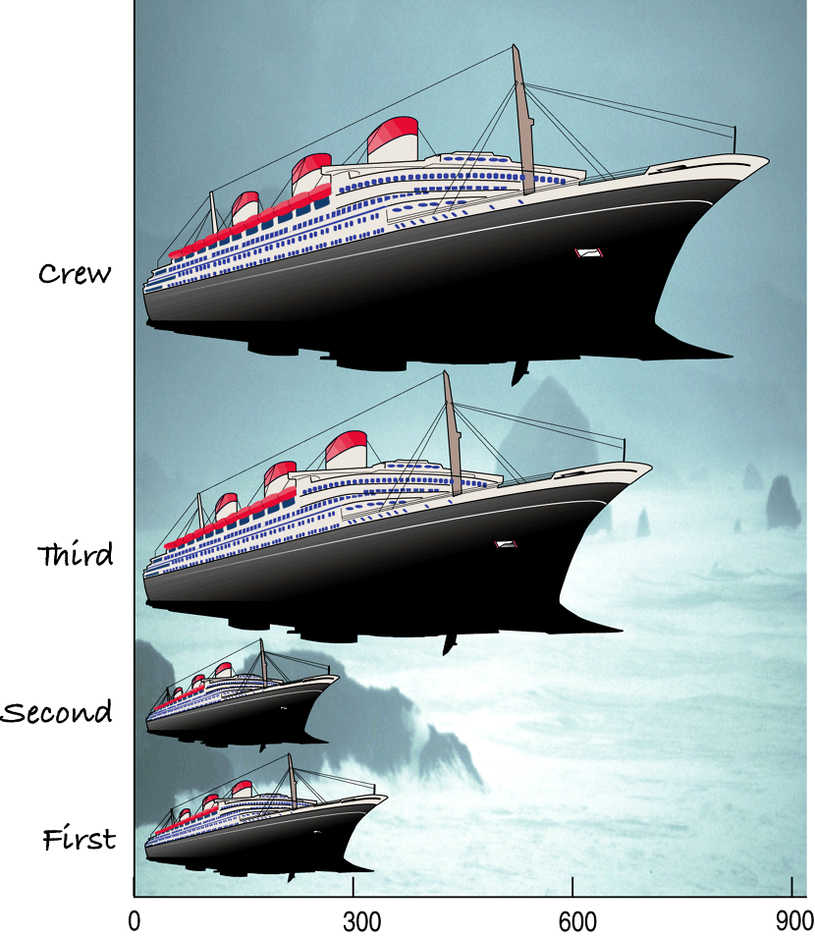
What’s Wrong With This Picture?
You might think that
a good way to show
the Titanic data is
with this display:

Slide 7
The Area Principle
The ship display makes it look like most of the people on the Titanic were crew members, with a few passengers along for the ride.
When we look at each ship, we see the area taken up by the ship, instead of the length of the ship.
The ship display violates the area principle:
The area occupied by a part of the graph should correspond to the size of the value it represents.

Slide 8
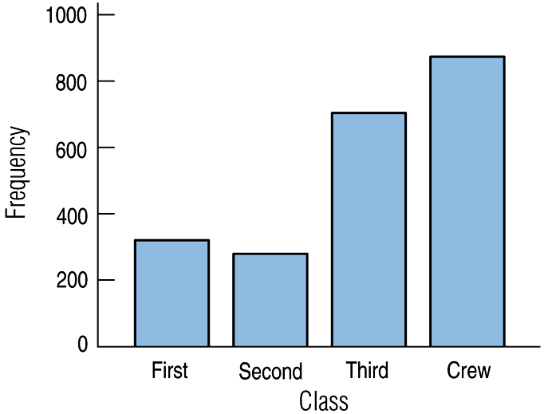
Bar Charts
A bar chart displays the distribution of a categorical variable, showing the counts for each category next to each other for easy comparison.
A bar chart stays true to the area principle.
The bars are usually
spaced apart to make
the graph more
readable.

Slide 9
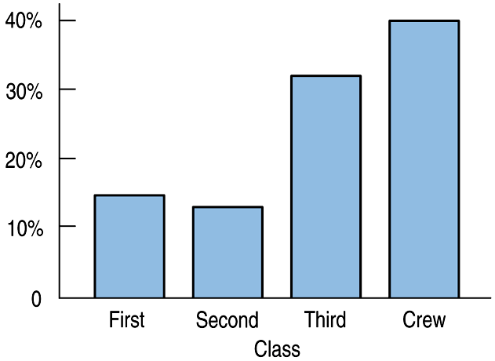
Bar Charts (cont.)
A relative frequency bar chart displays the relative proportion of counts for each category.
A relative frequency bar chart also stays true to the area principle.
Replacing counts with percentages in the ship data:
Doesn’t look much
different, does it?

Slide 10
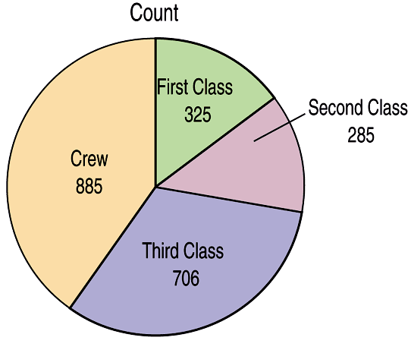
Pie Charts
When you are interested in parts of the whole, a pie chart might be your display of choice.
Pie charts show the whole group of cases as a circle.
They slice the circle into pieces whose size is proportional to the fraction of the whole in each category.

Slide 11
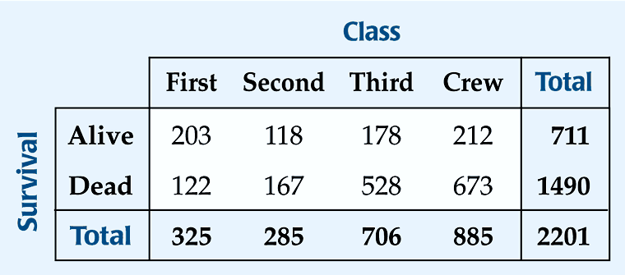
Contingency Tables
A contingency table allows us to look at two categorical variables together.
It shows how individuals are distributed along each variable, contingent on the value of the other variable.
Example: we can examine the class of ticket and whether a person survived the Titanic:

Slide 12
Contingency Tables (cont.)
The margins of the table, both on the right and on the bottom, give totals and the frequency distributions for each of the variables.
Each frequency distribution is called a marginal distribution of its respective variable.
The marginal distribution of Survival is:

Slide 13
Contingency Tables (cont.)
Each cell of the table gives the count for a combination of values of the two values.
For example, the second cell in the crew column tells us that 673 crew members died when the Titanic sunk.

Slide 14
Conditional Distributions
A conditional distribution shows the distribution of one variable for just the individuals who satisfy some condition on another variable.
The following is the conditional distribution of ticket Class, conditional on having survived:

Slide 15
Conditional Distributions (cont.)
The following is the conditional distribution of ticket Class, conditional on having perished:

Slide 16
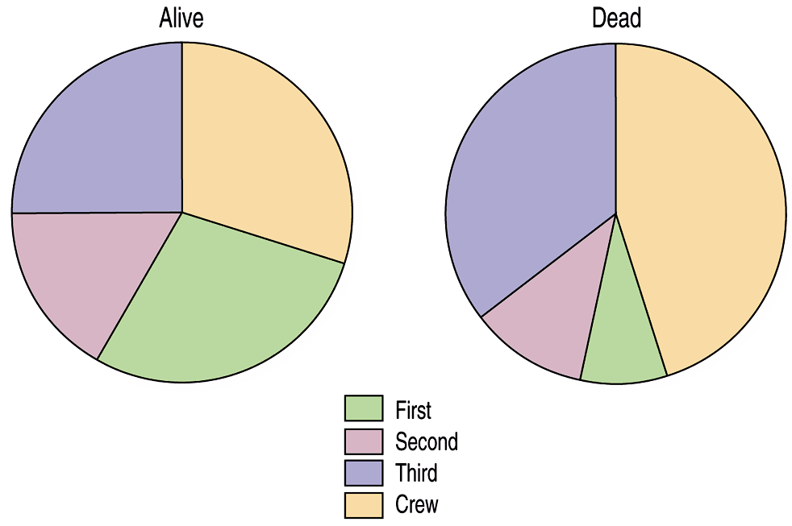
Conditional Distributions (cont.)
The conditional distributions tell us that there is a difference in class for those who survived and those who perished.
This is better shown with pie charts of the two distributions:

Slide 17
Conditional Distributions (cont.)
We see that the distribution of Class for the survivors is different from that of the nonsurvivors.
This leads us to believe that Class and Survival are associated, that they are not independent.
The variables would be considered independent when the distribution of one variable in a contingency table is the same for all categories of the other variable.

Slide 18
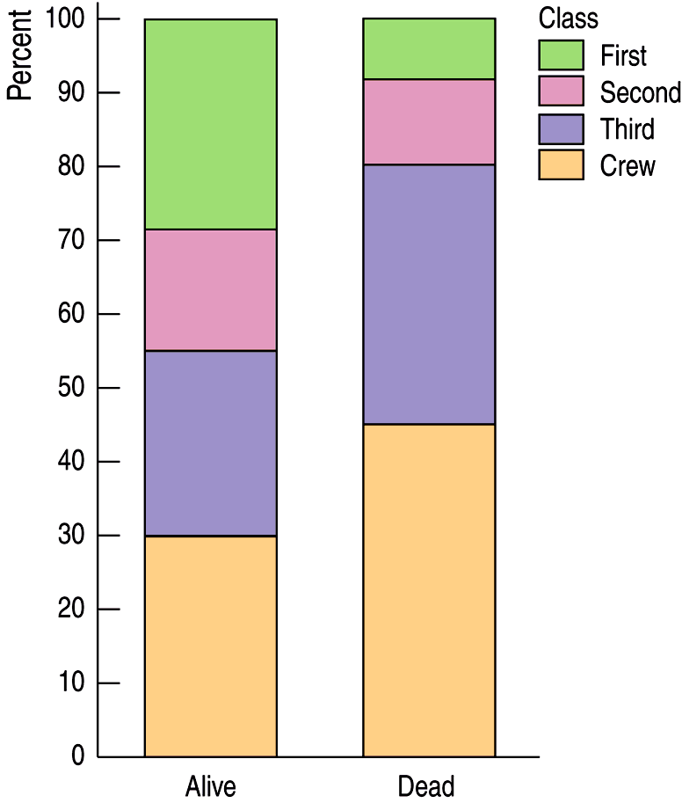
Segmented Bar Charts
A segmented bar chart displays the same information as a pie chart, but in the form of bars instead of circles.
Each bar is treated as the “whole” and is divided proportionally into segments corresponding to the percentage in each group.
Here is the segmented bar chart for ticket Class by Survival status:

Slide 19
Segmented Bar Charts
Note that using percentages is crucial. It allows us to compare groups of different sample sizes.

Slide 20
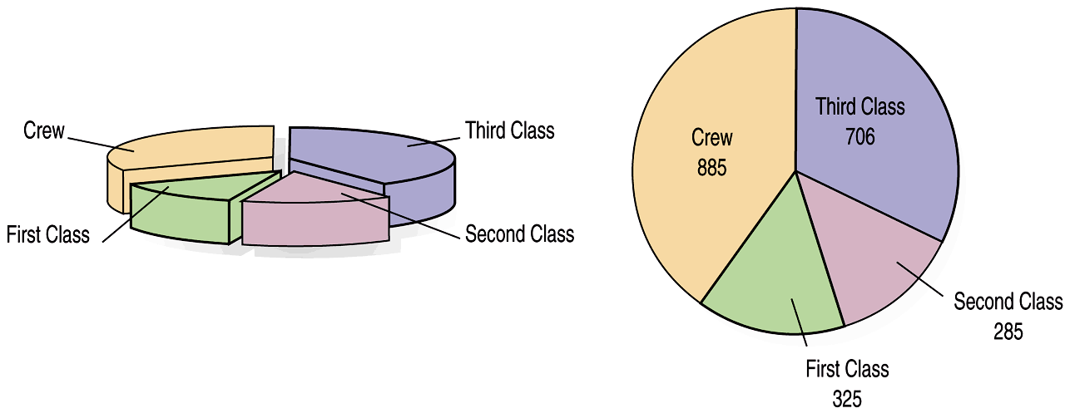
What Can Go Wrong?
Don’t violate the area principle.
While some people might like the pie chart on the left better, it is harder to compare fractions of the whole, which a flat pie chart does easily.

Slide 21
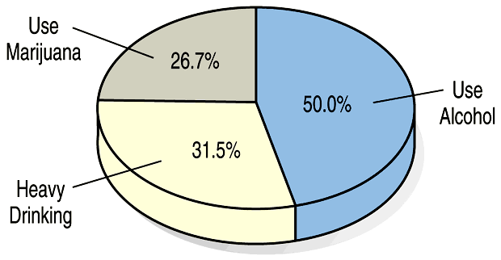
What Can Go Wrong? (cont.)
Keep it honest—make sure your display shows what it says it shows.
This plot of the percentage of high-school students who engage in specified dangerous behaviors has a problem. Can you see it?

Slide 22
What Can Go Wrong? (cont.)
Don’t confuse similar-sounding percentages—pay particular attention to the wording of the context. For example:
What percentage of seniors are males?
What percentage of males are seniors?
Don’t forget to look at the variables separately too—examine the marginal distributions, since it is important to know how many cases are in each category.

Slide 23
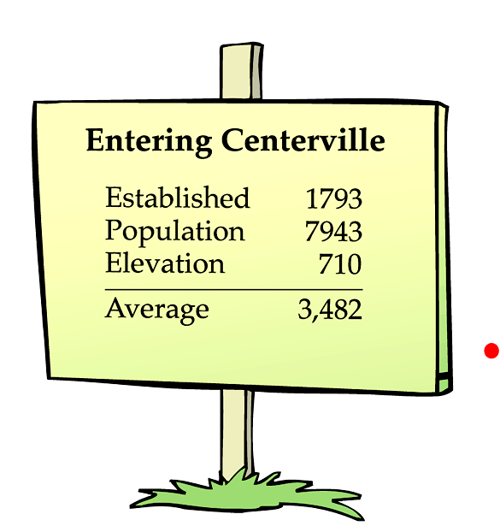
What Can Go Wrong? (cont.)
Don’t overstate your case—don’t claim something you can’t.
Don’t use unfair or silly averages—this could lead to Simpson’s Paradox, so be careful when you average one variable across different levels of a second variable.
Notes:
Note: Simpson’s Paradox is not an AP-topic.

Slide 24
Teaching tip
Simpson’s paradox is not an AP topic. It can be an interesting part of a class discussion or a group activity/exploration. But it is a topic that you may chose, in the interest of time and pace, to skip altogether.

Slide 25
What have we learned?
We can summarize categorical data by counting the number of cases in each category (expressing these as counts or percents).
We can display the distribution in a bar chart or pie chart.
And, we can examine two-way tables called contingency tables, examining marginal and/or conditional distributions of the variables.

Slide 26
AP Tips
Labels and scales on all graphs are required for full credit.

Slide 27
AP Tips, cont.
Checking for independence is a VERY important idea in this course. We will revisit this topic in Chapter 14 and again in Chapter 25!

Slide 28
AP Tips, cont.
Segmented bar graphs are powerful. But only when the categories add to a meaningful total. Take a look at the 2010 AP exam, problem #6. Why can this graph not be segmented?
There are many different correct graphs for this problem. How many can you make?

