Slide 1
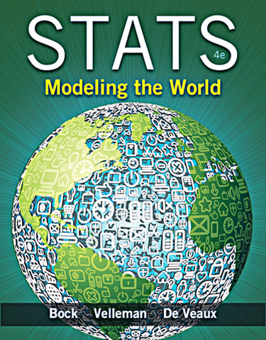
Chapter 4
Understanding and Comparing Distributions

Slide 2
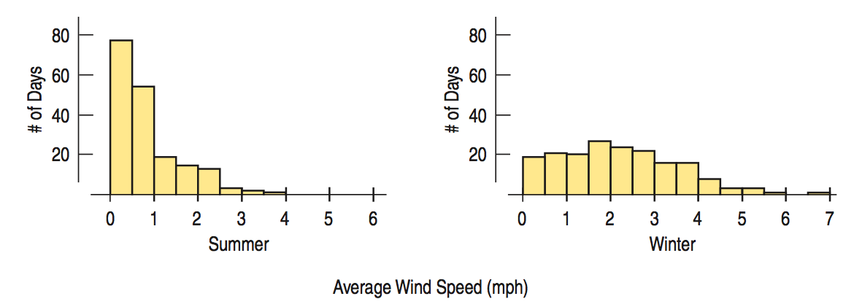
Comparing Groups
It is almost always more interesting to compare groups.
With histograms, note the shapes, centers, and spreads of the two distributions.
What does this graphical display tell you?
Notes:
A: Both distributions are skewed to the right, but summer is skewed more strongly. Summer has a much lower center than winter. The spread of winter is much less variable than summer.

Slide 3
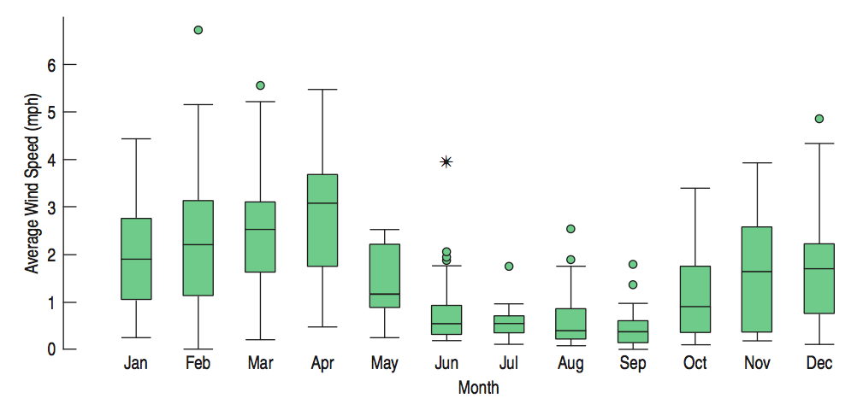
Comparing Groups (cont.)
Boxplots offer an ideal balance of information and simplicity, hiding the details while displaying the overall summary information.
We often plot them side by side for groups or categories we wish to compare.
What do these boxplots tell you?
Notes:
The asterisk indicates outliers that are 3 or more IQR’s from the quartiles. This is a common convention and will be used throughout the text. However, the AP test has yet to use this notation.

Slide 4
What About Outliers?
If there are any clear outliers and you are reporting the mean and standard deviation, report them with the outliers present and with the outliers removed. The differences may be quite revealing.
Note: The median and IQR are not likely to be affected by the outliers.

Slide 5
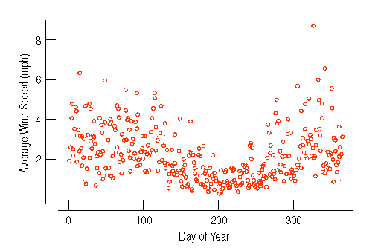
Timeplots: Order, Please!
For some data sets, we are interested in how the data behave over time. In these cases, we construct timeplots of the data.

Slide 6
A time plot of interest

Slide 7
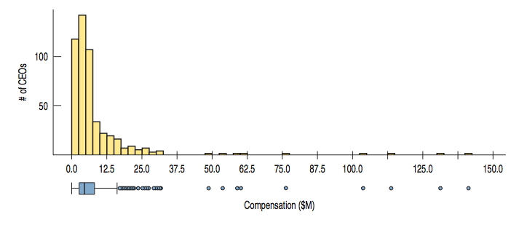
*Re-expressing Skewed Data to Improve Symmetry
When the data are skewed it can be hard to summarize them simply with a center and spread, and hard to decide whether the most extreme values are outliers or just part of a stretched out tail.
How can we say anything useful about such data?

Slide 8
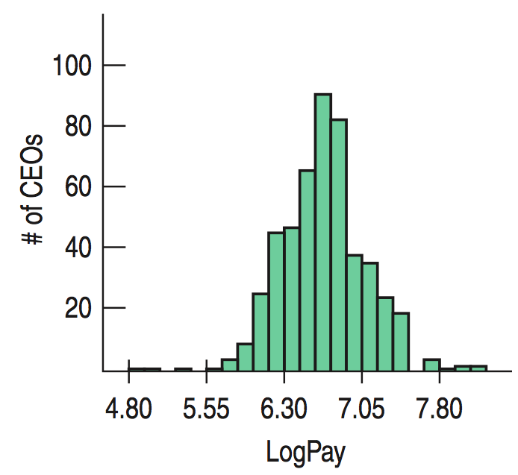
*Re-expressing Skewed Data to Improve Symmetry (cont.)
One way to make a skewed distribution more symmetric is to re-express or transform the data by applying a simple function (e.g., logarithmic function).
Note the change in skewness from the raw data (previous slide) to the transformed data (right):

Slide 9
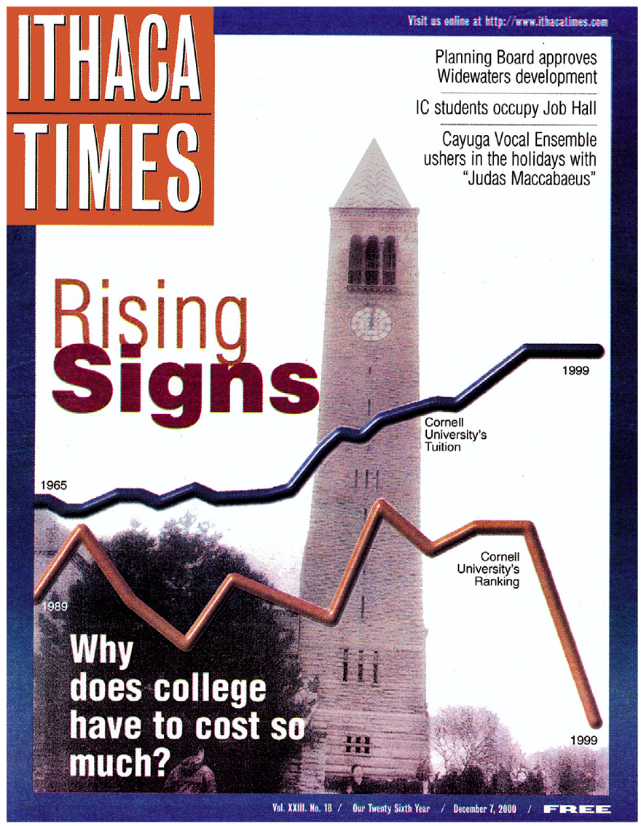
What Can Go Wrong? (cont.)
Avoid inconsistent scales, either within the display or when comparing two displays.
Label clearly so a reader knows what the plot displays.
Good intentions, bad plot:

Slide 10
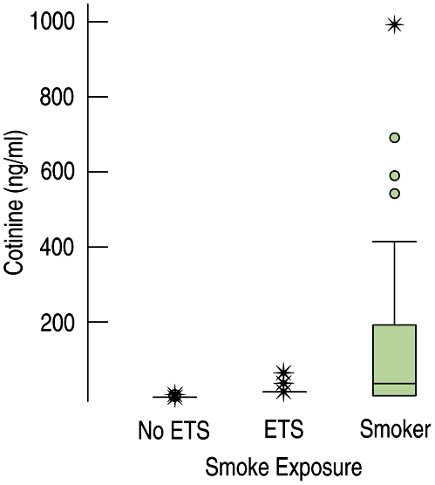
What Can Go Wrong? (cont.)
Beware of outliers
Be careful when comparing groups that have very different spreads.
Consider these side-by-side boxplots of cotinine levels:
Re-express . . .

Slide 11
What have we learned?
We’ve learned the value of comparing data groups and looking for patterns among groups and over time.
We’ve seen that boxplots are very effective for comparing groups graphically.
We’ve experienced the value of identifying and investigating outliers.
We’ve graphed data that has been measured over time against a time axis and looked for long-term trends both by eye and with a data smoother.

Slide 12
AP Tips
When comparing distributions, make sure to compare the center, shape and spread. All three are required for full credit.
When comparing center and spread, use comparison words. Examples:
“The mean was 34 mpg in group A, while the group B mean was 30 mpg.” (NOT full credit)
“Group A had a larger mean of 34 mpg compared to group B’s mean of 30 mpg.” (full credit)

