Slide 1
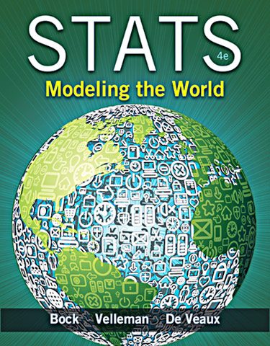
Chapter 6
Scatterplots, Association and Correlation

Slide 2
Looking at Scatterplots
Scatterplots may be the most common and most effective display for data.
In a scatterplot, you can see patterns, trends, relationships, and even the occasional extraordinary value sitting apart from the others.
Scatterplots are the best way to start observing the relationship and the ideal way to picture associations between two quantitative variables.

Slide 3
Looking at Scatterplots (cont.)
When looking at scatterplots, we will look for direction, form, strength, and unusual features.
Direction:
A pattern that runs from the upper left to the lower right is said to have a negative direction.
A trend running the other way has a positive direction.

Slide 4
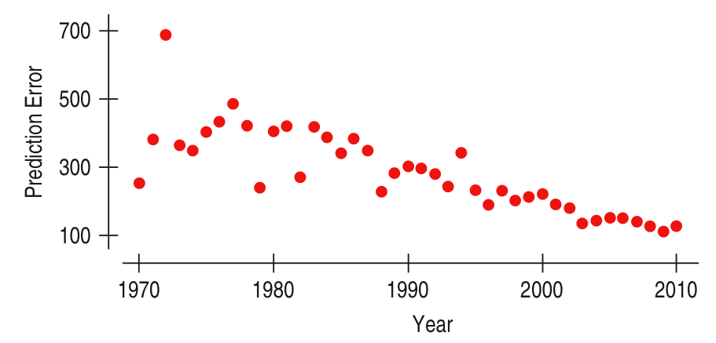
Looking at Scatterplots (cont.)
Can the NOAA predict where a hurricane will go?
The figure shows a negative direction between the year since 1970 and the and the prediction errors made by NOAA.
As the years have passed, the predictions have improved (errors have decreased).

Slide 5
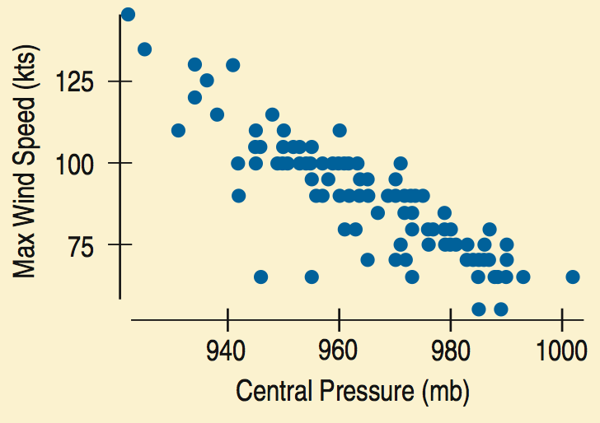
Looking at Scatterplots (cont.)
The example in the text shows a negative association between central pressure and maximum wind speed
As the central pressure increases, the maximum wind speed decreases.

Slide 6
Looking at Scatterplots (cont.)
Form:
If there is a straight line (linear) relationship, it will appear as a cloud or swarm of points stretched out in a generally consistent, straight form.

Slide 7
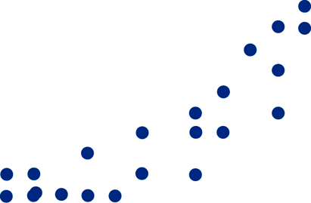
Looking at Scatterplots (cont.)
Form:
If the relationship isn’t straight, but curves gently, while still increasing or decreasing steadily,
we can often find ways to make it more nearly straight (chapter 9!).

Slide 8
Looking at Scatterplots (cont.)
Form:
If the relationship curves sharply,
a linear method is not helpful.

Slide 9
Looking at Scatterplots (cont.)
Strength:
At one extreme, the points appear to follow a single stream
(whether straight, curved, or bending all over the place).

Slide 10
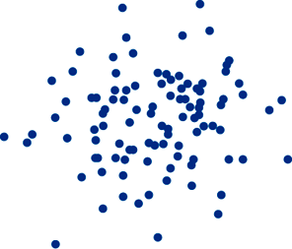
Looking at Scatterplots (cont.)
Strength:
At the other extreme, the points appear as a vague cloud with no discernible trend or pattern:
Note: we will quantify the amount of scatter soon.

Slide 11
Looking at Scatterplots (cont.)
Unusual features:
Look for the unexpected.
Often the most interesting thing to see in a scatterplot is the thing you never thought to look for.
One example of such a surprise is an outlier standing away from the overall pattern of the scatterplot.
Clusters or subgroups should also raise questions.

Slide 12
Roles for Variables
It is important to determine which of the two quantitative variables goes on the x-axis and which on the y-axis.
This determination is made based on the roles played by the variables.
When the roles are clear, the explanatory or predictor variable goes on the x-axis, and the response variable (variable of interest) goes on the y-axis.

Slide 13
Roles for Variables (cont.)
The roles that we choose for variables are more about how we think about them rather than about the variables themselves.
Just placing a variable on the x-axis doesn’t necessarily mean that it explains or predicts anything. And the variable on the y-axis may not respond to it in any way.

Slide 14
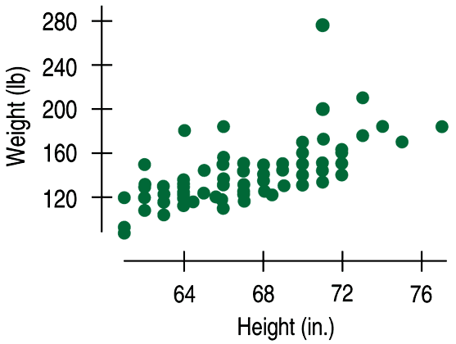
Correlation
Data collected from students in Statistics classes included their heights (in inches) and weights (in pounds):
Here we see a positive association and a fairly straight form, although there seems to be a high outlier.

Slide 15
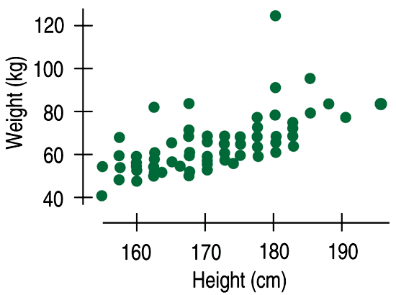
Correlation (cont.)
How strong is the association between weight and height of Statistics students?
If we had to put a number on the strength, we would not want it to depend on the units we used.
A scatterplot of heights (in centimeters) and weights (in kilograms) doesn’t change the shape of the pattern:

Slide 16
Teaching note
Depending on your class, you may choose to skip the next three slides. They will be fascinating to a group that is strong mathematically. But may only be confusing to other groups.

Slide 17
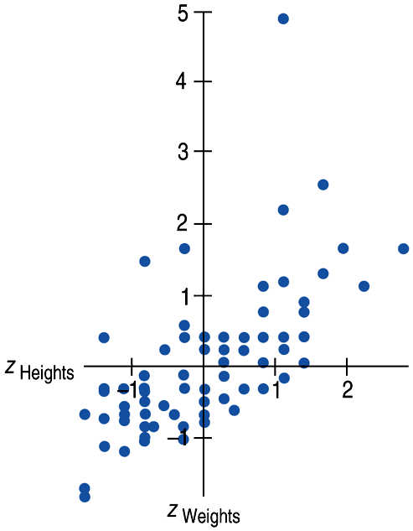
Correlation (cont.)
Since the units don’t matter, why not remove them altogether?
We could standardize both variables and write the coordinates of a point as (z_{x}, z_{y}).
Here is a scatterplot of the standardized weights and heights:

Slide 18
Correlation (cont.)
Note that the underlying linear pattern seems steeper in the standardized plot than in the original scatterplot.
That’s because we made the scales of the axes the same.
Equal scaling gives a neutral way of drawing the scatterplot and a fairer impression of the strength of the association.

Slide 19
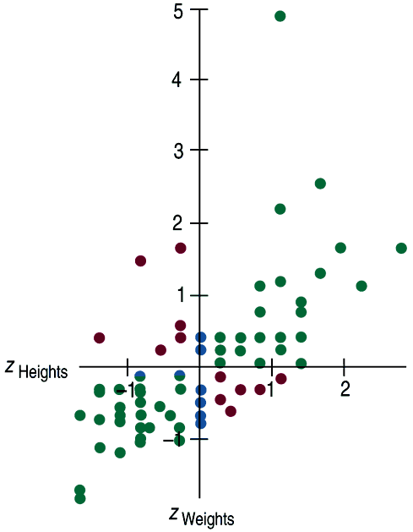
Correlation (cont.)
Some points (those in green) strengthen the impression of a positive association between height and weight.
Other points (those in red) tend to weaken the positive association.
Points with z-scores of zero (those in blue) don’t vote either way.

Slide 20
Correlation (cont.)
The correlation coefficient (r) gives us a numerical measurement of the strength of the linear relationship between the explanatory and response variables.

Slide 21
Correlation (cont.)
For the students’ heights and weights, the correlation is 0.644.
What does this mean?
The sign is positive, so it tells us there is a positive association.
0.644 is moderate in strength.
So we say a correlation of 0.644 tells us there is a positive, moderate, linear relationship between height and weight.
Of course, we’d also like to see a scatterplot!
Notes:
Do not spend time calculating this value by hand!

Slide 22
Correlation Conditions
Correlation measures the strength of the linear association between two quantitative variables.
Before you use correlation, you must check several conditions:
Quantitative Variables Condition
Straight Enough Condition
Outlier Condition

Slide 23
Correlation Conditions (cont.)
Quantitative Variables Condition:
Correlation applies only to quantitative variables.
Don’t apply correlation to categorical data masquerading as quantitative.
Check that you know the variables’ units and what they measure.

Slide 24
Correlation Conditions (cont.)
Straight Enough Condition:
Correlation measures the strength only of the linear association, and will be misleading if the relationship is not linear.
Thus we only calculate and use the correlation coefficient for linear data.

Slide 25
Correlation Conditions (cont.)
Outlier Condition:
Outliers can distort the correlation dramatically.
An outlier can make an otherwise small correlation look big or hide a large correlation.
It can even give an otherwise positive association a negative correlation coefficient (and vice versa).
When you see an outlier, it’s often a good idea to report the correlations with and without the point.

Slide 26
Correlation Properties
The sign of a correlation coefficient gives the direction of the association.
Correlation is always between –1 and +1.
Correlation can be exactly equal to –1 or +1, but these values are unusual in real data because they mean that all the data points fall exactly on a single straight line.
A correlation near zero corresponds to a weak linear association.

Slide 27
Correlation Properties (cont.)
Correlation treats x and y symmetrically:
The correlation of x with y is the same as the correlation of y with x.
Correlation has no units.
Correlation is not affected by changes in the center or scale of either variable.
Correlation depends only on the z-scores, and they are unaffected by changes in center or scale.

Slide 28
Correlation Properties (cont.)
Correlation measures the strength of the linear association between the two variables.
Variables can have a strong association but still have a small correlation if the association isn’t linear.
Correlation is sensitive to outliers. A single outlying value can make a small correlation large or make a large one small.

Slide 29
Review Question!
Which statistics have we studied so far this year that are resistant?
Which statistics are not resistant?
Notes:
Teaching tip: In this course, median and IQR are the only non-resistant statistics we cover. That’s a short list!

Slide 30
Correlation ≠ Causation
Whenever we have a strong correlation, it is tempting to explain it by imagining that the predictor variable has caused the response to help.
Scatterplots and correlation coefficients never prove causation.
A hidden variable that stands behind a relationship and determines it by simultaneously affecting the other two variables is called a lurking variable.

Slide 31
Straightening Scatterplots
Straight line relationships are the ones that we can measure with correlation.
When a scatterplot shows a bent form that consistently increases or decreases, we can often straighten the form of the plot by re-expressing one or both variables.
We will cover straightening techniques in
Chapter 9.

Slide 32
What Can Go Wrong?
Don’t say “correlation” when you mean “association.”
More often than not, people say correlation when they mean association.
The word “correlation” should be reserved for measuring the strength and direction of the linear relationship between two quantitative variables.

Slide 33
What Can Go Wrong?
Don’t correlate categorical variables.
Be sure to check the Quantitative Variables Condition.
Don’t confuse “correlation” with “causation.”
Scatterplots and correlations never demonstrate causation.
These statistical tools can only demonstrate an association between variables.

Slide 34
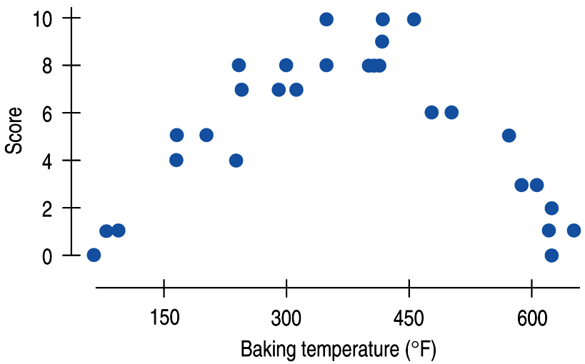
What Can Go Wrong? (cont.)
Be sure the association is linear.
There may be a strong association between two variables that have a nonlinear association.

Slide 35
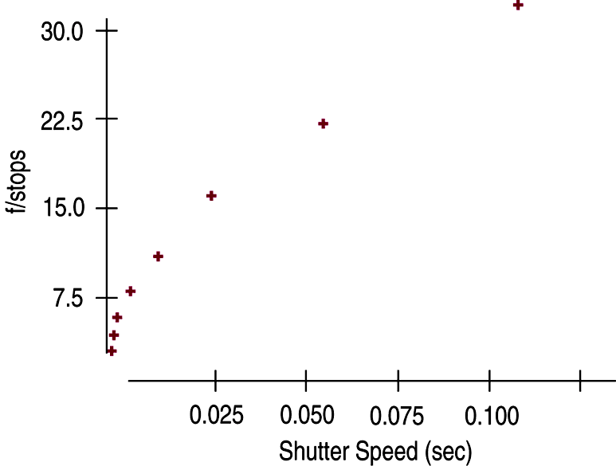
What Can Go Wrong? (cont.)
Don’t assume the relationship is linear just because the correlation coefficient is high.
Here the correlation is 0.979, but the relationship is actually bent.

Slide 36
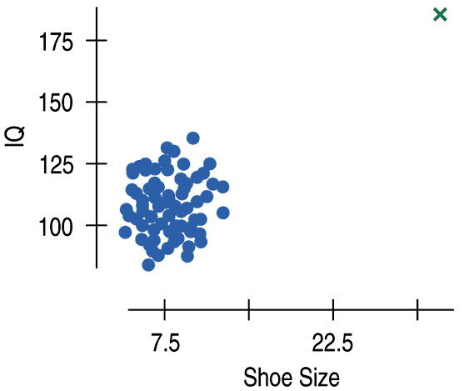
What Can Go Wrong? (cont.)
Beware of outliers.
Even a single outlier
can dominate the correlation value.
Make sure to check the Outlier Condition.
We will discuss outliers
in Chapter 8.

Slide 37
What have we learned?
We examine scatterplots for direction, form, strength, and unusual features.
Although not every relationship is linear, when the scatterplot is straight enough, the correlation coefficient is a useful numerical summary.
The sign of the correlation tells us the direction of the association.
The magnitude of the correlation tells us the strength of a linear association.
Correlation has no units, so shifting or scaling the data, standardizing, or swapping the variables has no effect on the numerical value.

Slide 38
What have we learned? (cont.)
Doing Statistics right means that we have to Think about whether our choice of methods is appropriate.
Before finding or talking about a correlation, check the Straight Enough Condition.
Watch out for outliers!
Don’t assume that a high correlation or strong association is evidence of a cause-and-effect relationship—beware of lurking variables!

Slide 39
Teaching Tip
One of the best ways to finish this lesson is to play “Guess my correlation!” on one of the websites that provide such an applet. You can find a list of applets on the SMW4e web page.
A few rounds of this game is fun and will quickly reinforce what r tells us.

Slide 40
AP Tips
Just like the rest of the graphs in this course, scales and labels are required for full credit.
You don’t have to start either axes at zero, but once you start scaling an axes, it should keep the same scale for its entire length.
Describing a scatterplot should be done in context and include the form, strength and association.
“There is a strong, positive, and linear relationship between age and height.”

Slide 41
AP Tips, cont.
We usually refer to r as simply correlation. But the AP test usually refers to r as the correlation coefficient. Don’t get confused by the additional word coefficient. It’s just r.

