Slide 1
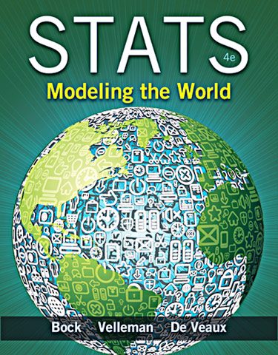
Chapter 10
Understanding Randomness

Slide 2
Why Be Random?
What is it about chance outcomes being random that makes random selection seem fair? Two things:
Nobody can guess the outcome before it happens.
When we want things to be fair, usually some underlying set of outcomes will be equally likely (although in many games some combinations of outcomes are more likely than others).

Slide 3
Why Be Random? (cont.)
Example:
Pick “heads” or “tails.”
Flip a fair coin. Does the outcome match your choice? Did you know before flipping the coin whether or not it would match?

Slide 4
Why Be Random? (cont.)
Statisticians don’t think of randomness as the annoying tendency of things to be unpredictable or haphazard.
Statisticians use randomness as a tool.
But, truly random values are surprisingly hard to get…

Slide 5
It’s Not Easy Being Random
It’s surprisingly difficult to generate random values even when they’re equally likely.
Computers have become a popular way to generate random numbers.
Even though they often do much better than humans, computers can’t generate truly random numbers either.
Since computers follow programs, the “random” numbers we get from computers are really pseudorandom.
Fortunately, pseudorandom values are good enough for most purposes.

Slide 6
It’s Not Easy Being Random (cont.)
There are ways to generate random numbers so that they are both equally likely and truly random.
The best ways we know to generate data that give a fair and accurate picture of the world rely on randomness, and the ways in which we draw conclusions from those data depend on the randomness, too.

Slide 7
Practical Randomness
We need an imitation of a real process so we can manipulate and control it.
In short, we are going to simulate reality.

Slide 8
A Simulation
The sequence of events we want to investigate is called a trial.
The basic building block of a simulation is called a component.
Trials usually involve several components.
After the trial, we record what happened—our response variable.
There are seven steps to a simulation…

Slide 9
Simulation Steps
Identify the component to be repeated.
Explain how you will model the component’s outcome.
Explain how you will combine the components to model a trial.
State clearly what the response variable is.
Run several trials.
Collect and summarize the results of all the trials.
State your conclusion.

Slide 10
What Can Go Wrong?
Don’t overstate your case.
Beware of confusing what really happens with what a simulation suggests might happen.
Model outcome chances accurately.
A common mistake in constructing a simulation is to adopt a strategy that may appear to produce the right kind of results.
Run enough trials.
Simulation is cheap and fairly easy to do.

Slide 11
What have we learned?
How to harness the power of randomness.
A simulation model can help us investigate a question when we can’t (or don’t want to) collect data, and a mathematical answer is hard to calculate.
How to base our simulation on random values generated by a computer, generated by a randomizing device, or found on the Internet.
Simulations can provide us with useful insights about the real world.

Slide 12
Why bother?
Some simple simulations are easier just to calculate. For example, we will simulate the binomial distribution in Chapter 16 but can calculate the theoretical probability more quickly.
However, we can simulate complex procedures whose theoretical probability would be very difficult to calculate.

Slide 13
For example…
We will learn in Chapter 22 that Gossett used simulations to discover a new distribution used for small samples.
Statisticians use computer simulations to explore complex scenarios.
A computer can “contain” a large population and statisticians can see what happens when that population is sampled under certain conditions.

Slide 14
AP Tips
When describing a simulation, be VERY specific about the steps needed to run it.
Be able to describe a simulation with technology, physical objects (like numbers in a hat) or with a random digit table.
Always take careful note about whether your simulation is taking place with or without replacement.

