Slide 1
Chapter 12
Experiments and Observational Studies

Slide 2
Observational Studies
In an observational study, researchers don’t assign choices; they simply observe them.
The text’s example looked at the relationship between music education and grades.
Since the researchers did not assign students to get music education and simply observed students “in the wild,” it was an observational study.

Slide 3
Observational Studies (cont.)
Because researchers in the text example first identified subjects who studied music and then collected data on their past grades, this was a retrospective study.
Had the researchers identified subjects in advance and collected data as events unfolded, the study would have been a prospective study.

Slide 4
Observational Studies (cont.)
Observational studies are valuable for discovering trends and possible relationships.
However, it is not possible for observational studies, whether prospective or retrospective, to demonstrate a causal relationship.

Slide 5
Randomized, Comparative Experiments
An experiment is a study design that allows us to prove a cause-and-effect relationship.
In an experiment, the experimenter must identify at least one explanatory variable, called a factor, to manipulate and at least one response variable to measure.
An experiment:
Manipulates factor levels to create treatments.
Randomly assigns subjects to these treatment levels.
Compares the responses of the subject groups across treatment levels.

Slide 6
Randomized, Comparative Experiments (cont.)
In an experiment, the experimenter actively and deliberately manipulates the factors to control the details of the possible treatments, and assigns the subjects to those treatments at random.
The experimenter then observes the response variable and compares responses for different groups of subjects who have been treated differently.

Slide 7
Randomized, Comparative Experiments (cont.)
In general, the individuals on whom or which we experiment are called experimental units.
When humans are involved, they are commonly called subjects or participants.
The specific values that the experimenter chooses for a factor are called the levels of the factor.
A treatment is a combination of specific levels from all the factors that an experimental unit receives.

Slide 8
The Four Principles of Experimental Design
Control:
We control sources of variation other than the factors we are testing by making conditions as similar as possible for all treatment groups.
Randomize:
Randomization allows us to equalize the effects of unknown or uncontrollable sources of variation.
It does not eliminate the effects of these sources, but it spreads them out across the treatment levels so that we can see past them.
Without randomization, you do not have a valid experiment and will not be able to use the powerful methods of Statistics to draw conclusions from your study.

Slide 9
The Four Principles of Experimental Design (cont.)
Replicate:
Repeat the experiment, applying the treatments to a number of subjects.
Later this year we will learn how our sample size helps us calculate how precisely our statistic estimates the true parameter.
(We will learn how to calculate a margin of error, just like you read in the newspaper, e.g., ±3%.)

Slide 10
The Four Principles of Experimental Design (cont.)
Block:
Sometimes, attributes of the experimental units that we are not studying and that we can’t control may nevertheless affect the outcomes of an experiment.
If we group similar individuals together and then randomize within each of these blocks, we can remove much of the variability due to the difference among the blocks.
Note: Blocking is an important compromise between randomization and control, but, unlike the first three principles, is not required in an experimental design.

Slide 11
Diagrams of Experiments
It’s often helpful to diagram the procedure of an experiment.
The following diagram emphasizes the random allocation of subjects to treatment groups, the separate treatments applied to these groups, and the ultimate comparison of results:

Slide 12
Does the Difference Make a Difference?
How large do the differences need to be to say that there is a difference in the treatments?
Differences that are larger than we’d get just from the randomization alone are called statistically significant.
We’ll talk more about statistical significance later on. For now, the important point is that a difference is statistically significant if we don’t believe that it’s likely to have occurred only by chance.

Slide 13
Experiments and Samples
Both experiments and sample surveys use randomization to get unbiased data.
But they do so in different ways and for different purposes:
Sample surveys attempt to randomly select participants from the population.
Experiments are usually done with a pool of volunteers (which can create its own set of difficulties). But we randomly assign the treatments to our volunteers to reduce bias.

Slide 14
Control Treatments
Often, we want to compare a situation involving a specific treatment to the status quo situation.
A baseline (“business as usual”) measurement is called a control treatment, and the experimental units to whom it is applied is called the control group.

Slide 15
Blinding
When we know what treatment was assigned, it’s difficult not to let that knowledge influence our assessment of the response, even when we try to be careful.
In order to avoid the bias that might result from knowing what treatment was assigned, we use blinding.

Slide 16
Blinding (cont.)
There are two main classes of individuals who can affect the outcome of the experiment:
those who could influence the results (subjects, treatment administrators, technicians)
those who evaluate the results (judges, treating physicians, etc.)
When all individuals in either one of these classes are blinded, an experiment is said to be single-blind.
When everyone in both classes is blinded, the experiment is called double-blind.

Slide 17
Placebos
Often simply applying any treatment can induce an improvement.
To separate out the effects of the treatment of interest, we can use a control treatment that mimics the treatment itself.
A “fake” treatment that looks just like the treatment being tested is called a placebo.
Placebos are the best way to blind subjects from knowing whether they are receiving the treatment or not.

Slide 18
Placebos (cont.)
The placebo effect occurs when taking the sham treatment results in a change in the response variable.
This highlights both the importance of effective blinding and the importance of comparing treatments with a control.
Placebo controls are so effective that you should use them as an essential tool for blinding whenever possible.

Slide 19
The Best Experiments…
are usually:
randomized.
comparative.
double-blind.
a control group (either placebo or a standard treatment)

Slide 20
Blocking
When groups of experimental units are similar, it’s often a good idea to gather them together into blocks.
Blocking isolates the variability due to the differences between the blocks so that we can see the differences due to the treatments more clearly.
When randomization occurs only within the blocks, we call the design a randomized block design.

Slide 21
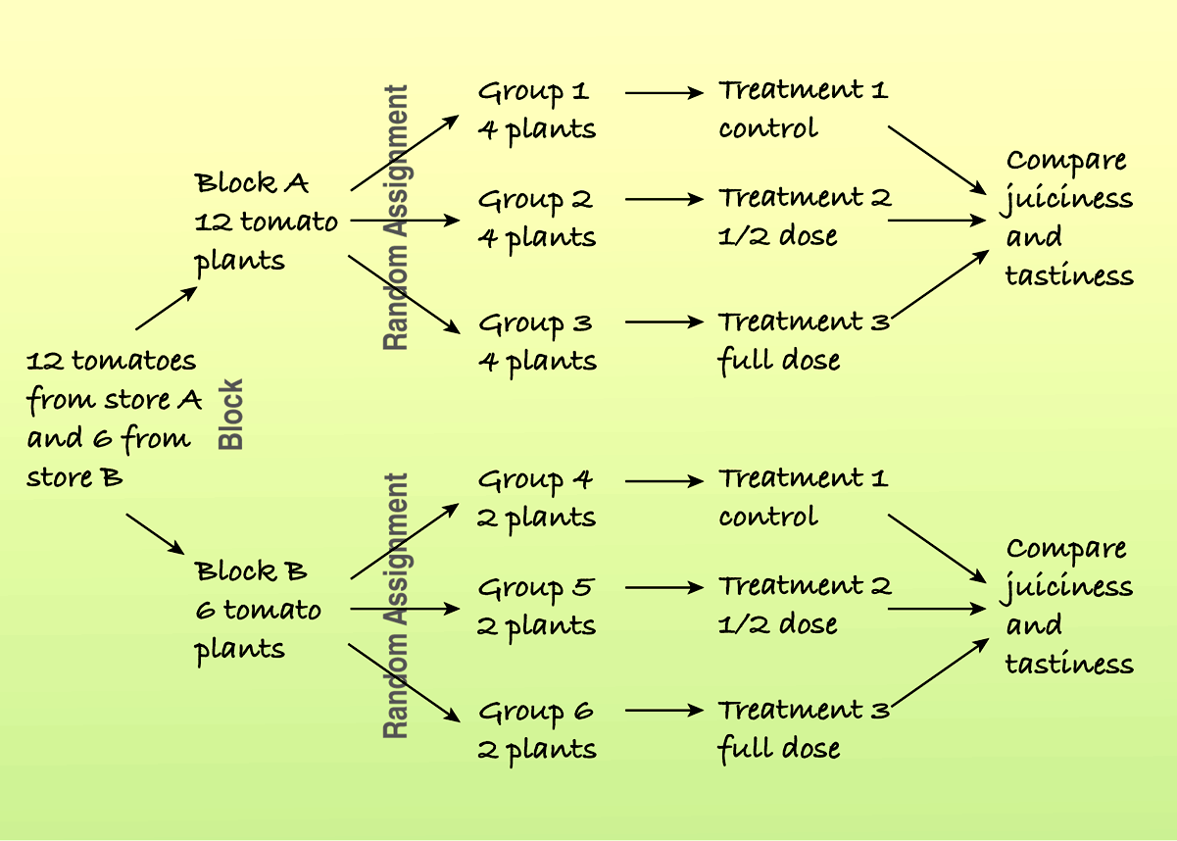
Blocking (cont.)
Here is a diagram of a blocked experiment:

Slide 22
Blocks and treatments
Be careful reading the previous diagram. We have only three treatment groups (not six).
Our goal is to ensure that each treatment group will have 4 store A tomatoes and 2 store B tomatoes.
This way we can isolate the effect of the fertilizer and eliminate any store A vs. store B differences.

Slide 23
Blocking (cont.)
In a retrospective or prospective study, subjects are sometimes paired because they are similar in ways not under study.
Matching subjects in this way can reduce variability in much the same way as blocking.

Slide 24
Blocking (cont.)
Blocking is the same idea for experiments as stratifying is for sampling.
Both methods group together subjects that are similar and randomize within those groups as a way to remove unwanted variation.
We use blocks to reduce variability so we can see the effects of the factors; we’re not usually interested in studying the effects of the blocks themselves.

Slide 25
AP Tip
The AP rubrics require that blocking descriptions focus on the use of blocking to reduce variability within the treatment groups. Not a discussion of comparing differences in the blocked groups.

Slide 26
Adding More Factors
It is often important to include multiple factors in the same experiment in order to examine what happens when the factor levels are applied in different combinations.

Slide 27
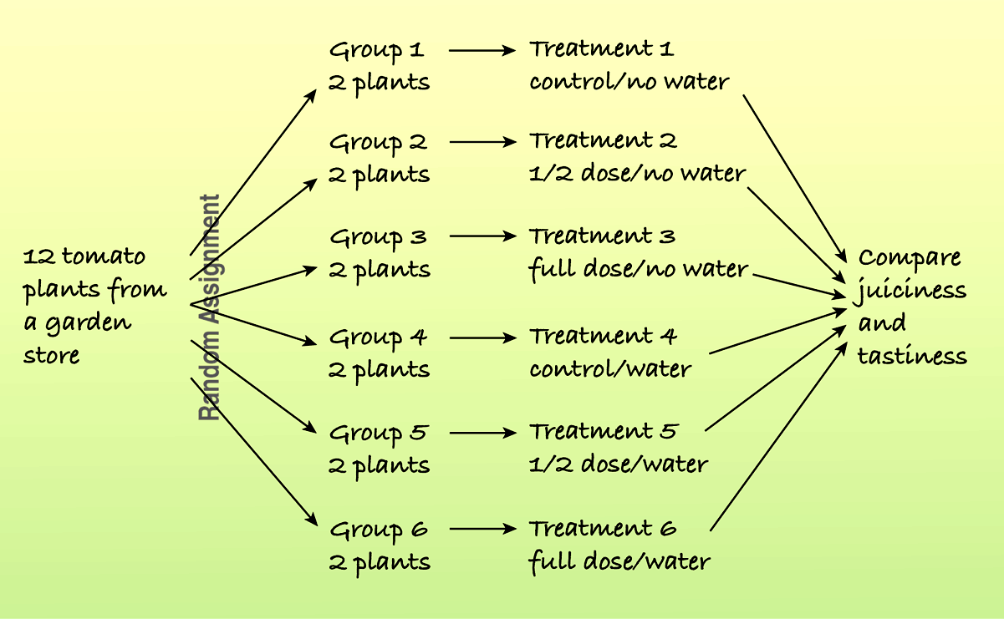
Adding More Factors (cont.)
For example, the following diagram shows a study of the effects of different fertilizer/water combinations on the juiciness and tastiness of tomatoes:

Slide 28
Confounding
When the levels of one factor are associated with the levels of another factor, we say that these two factors are confounded.
When we have confounded factors, we cannot separate out the effects of one factor from the effects of the other factor.

Slide 29
Confounding (cont.)
Confounding can arise in experiments when some other variables associated with a factor has an effect on the response variable.
A confounding variable is a third variable that is unfortunately intertwined in our experiment.
Our goal is to measure how the factor affects the response variable. But when another variable is intertwined with the factor and we can’t tell how much each of these variables is effecting the response variable, we describe this problem as confounding.

Slide 30
Confounding example
We wish to see if detergent A cleans better than detergent B.
Detergent A is used in one washing machine and detergent B is used in a different machine.
At the end of this experiment, we have confounding. That is, we cannot tell if a difference in the cleanliness of the clothes is caused by the detergent or by the quality of the machine that was used.

Slide 31
Lurking Variables
A variety of variables may be influencing a given situation.
Sometimes isolating the effect of one variable may be difficult.
There may be “lurking” variables that we need to think about. We sometimes discuss the potential effects of these other variables.

Slide 32
What Can Go Wrong?
Don’t give up just because you can’t run an experiment.
If we can’t perform an experiment, often an observational study is a good choice.
Beware of confounding.
Use randomization whenever possible to ensure that the factors not in your experiment are not confounded with your treatment levels.
Be alert to confounding that cannot be avoided, and report it along with your results.

Slide 33
What Can Go Wrong? (cont.)
Bad things can happen even to good experiments.
Protect yourself by recording additional information.
Don’t spend your entire budget on the first run.
Try a small pilot experiment before running the full-scale experiment.
You may learn some things that will help you make the full-scale experiment better.

Slide 34
What have we learned?
We can recognize sample surveys, observational studies, and randomized comparative experiments.
These methods collect data in different ways and lead us to different conclusions.
We can identify retrospective and prospective observational studies and understand the advantages and disadvantages of each.
Only well-designed experiments can allow us to reach cause-and-effect conclusions.
We manipulate levels of treatments to see if the factor we have identified produces changes in our response variable.

Slide 35
What have we learned? (cont.)
We know the principles of experimental design:
Identify and control as many other sources of variability as possible so we can be sure that the variation in the response variable can be attributed to our factor.
Try to equalize the many possible sources of variability that cannot be identified by randomly assigning experimental units to treatments.
Replicate the experiment on as many subjects as possible.
Control the sources of variability we can, and consider blocking to reduce variability from sources we recognize but cannot control.

Slide 36
What have we learned? (cont.)
We’ve learned the value of having a control group and of using blinding and placebo controls.
We can recognize problems posed by confounding variables in experiments and lurking variables in observational studies.

Slide 37
Teaching Tip
It is fairly easy to find medical studies for students to read. For example, the Cold-eeze medication keeps links to medical studies on their web site. Reading articles like these helps students appreciate how care scientists are when the run experiments.
This is a crucial unit for the use old AP problems. The free response problems and their rubrics will challenge students to be very clear in their communication.

Slide 38
AP Tips
As with stratification, make sure to justify your choice of blocks according to the parameter of interest.
Blocks are to ensure that variability is reduced across the treatment groups. NOT to create more groups to compare.
Write specifically and in detail.
Usually one of the six multiple choice questions is focused on survey or experimental design.

Slide 39
AP Tips
Don’t be confused by double-blinding. There is an assistant who sets up the medications and the code for each treatment. So someone knows who is receiving each treatment. But the subjects and the administrators/examiners won’t know during the course of the experiment.
Remember that with surveys and observational studies, we can only conclude that we have an association. With experiments, we can say we have a causal conclusion.

Slide 40
AP Tips
The key difference between a survey and an experiment is that in an experiment we apply a treatment to the subjects.

