Slide 1
Chapter 14
Probability Rules!

Slide 2
The General Addition Rule
When two events A and B are disjoint, we can use the addition rule for disjoint events from Chapter 13:
However, when our events are not disjoint, this earlier addition rule will double count the probability of both A and B occurring. Thus, we need the General Addition Rule.
Let’s look at a picture…

Slide 3
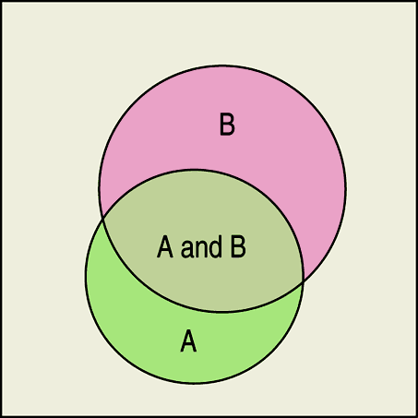
The General Addition Rule (cont.)
General Addition Rule:
For any two events A and B,
The following Venn diagram shows a situation in which we would use the general addition rule:

Slide 4
It Depends…
Back in Chapter 3, we looked at contingency tables and talked about conditional distributions.
When we want the probability of an event from a conditional distribution, we write P(B|A) and pronounce it “the probability of B given A.”
A probability that takes into account a given condition is called a conditional probability.

Slide 5
It Depends… (cont.)
To find the probability of the event B given the event A, we restrict our attention to the outcomes in A. We then find the fraction of those outcomes B that also occurred.
Note: P(A) cannot equal 0, since we know that A has occurred.

Slide 6
The General Multiplication Rule
When two events A and B are independent, we can use the multiplication rule for independent events from Chapter 14:
However, when our events are not independent, this earlier multiplication rule does not work. Thus, we need the General Multiplication Rule.

Slide 7
The General Multiplication Rule (cont.)
We encountered the general multiplication rule in the form of conditional probability.
Rearranging the equation in the definition for conditional probability, we get the General Multiplication Rule:
For any two events A and B,
or

Slide 8
Independence
Independence of two events means that the outcome of one event does not influence the probability of the other.
With our new notation for conditional probabilities, we can now formalize this definition:
Events A and B are independent whenever P(B|A) = P(B). (Equivalently, events A and B are independent whenever P(A|B) = P(A).)

Slide 9
Independent ≠ Disjoint
Disjoint events cannot be independent! Well, why not?
Since we know that disjoint events have no outcomes in common, knowing that one occurred means the other didn’t.
Thus, the probability of the second occurring changed based on our knowledge that the first occurred.
It follows, then, that the two events are not independent.
A common error is to treat disjoint events as if they were independent, and apply the Multiplication Rule for independent events—don’t make that mistake.

Slide 10
Depending on Independence
It’s much easier to think about independent events than to deal with conditional probabilities.
It seems that most people’s natural intuition for probabilities breaks down when it comes to conditional probabilities.
Don’t fall into this trap: whenever you see probabilities multiplied together, stop and ask whether you think they are really independent.

Slide 11
Drawing Without Replacement
Sampling without replacement means that once one individual is drawn it doesn’t go back into the pool.
We often sample without replacement, which doesn’t matter too much when we are dealing with a large population.
However, when drawing from a small population, we need to take note and adjust probabilities accordingly.
Drawing without replacement is just another instance of working with conditional probabilities.

Slide 12
Tree Diagrams
A tree diagram helps us think through conditional probabilities by showing sequences of events as paths that look like branches of a tree.
Making a tree diagram for situations with conditional probabilities is consistent with our “make a picture” mantra.

Slide 13
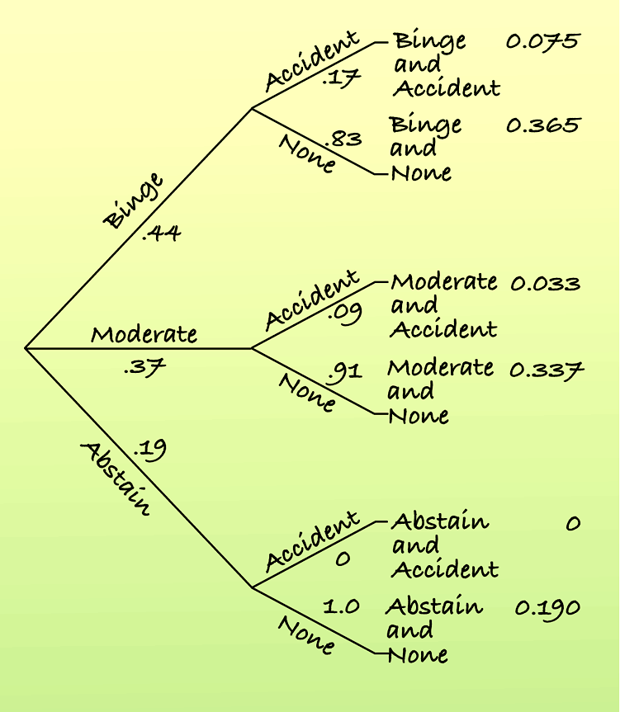
Tree Diagrams (cont.)
This figure is a nice example of a tree diagram and shows how we multiply the probabilities of the branches together.
All the final outcomes are disjoint and must add up to one.
We can add the final probabilities to find probabilities of compound events.

Slide 14
Reversing the Conditioning
Reversing the conditioning of two events is rarely intuitive.
Suppose we want to know P(A|B), and we know only P(A), P(B), and P(B|A).
We also know , since
From this information, we can find P(A|B):

Slide 15
What Can Go Wrong?
Don’t use a simple probability rule where a general rule is appropriate:
Don’t assume that two events are independent or disjoint without checking that they are.
Don’t find probabilities for samples drawn without replacement as if they had been drawn with replacement.
Don’t reverse conditioning naively.
Don’t confuse “disjoint” with “independent.”

Slide 16
What have we learned?
The probability rules from Chapter 13 only work in special cases—when events are disjoint or independent.
We now know the General Addition Rule and General Multiplication Rule.
We also know about conditional probabilities and that reversing the conditioning can give surprising results.

Slide 17
What have we learned? (cont.)
Venn diagrams, tables, and tree diagrams help organize our thinking about probabilities.
We now know more about independence—a sound understanding of independence will be important throughout the rest of this course.

Slide 18
AP Tips
Read conditional probabilities carefully.
Most AP problems use data for probability problems. Become skilled at finding probabilities from 2-way tables.
Checking independence on a 2-way table is a crucial skill.

